Slide 1
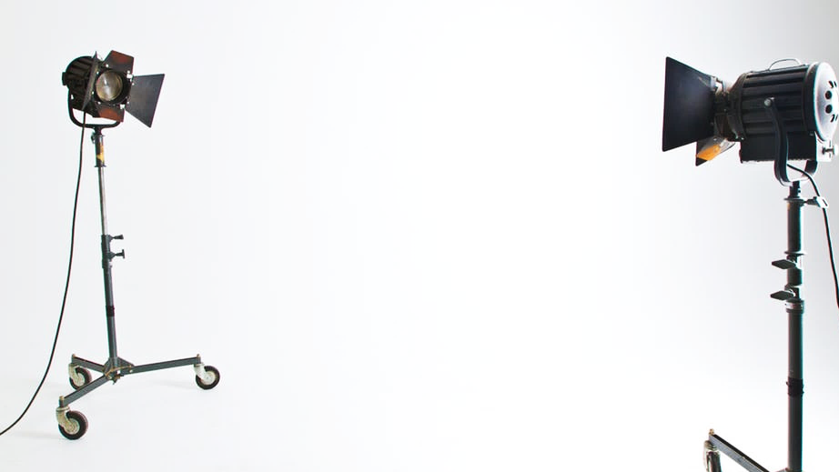

Influencer marketing
Proposal template
by

Slide 2

Influencer marketing campaign
Marketing stuff
© SushiVid SDN BHD

Slide 3
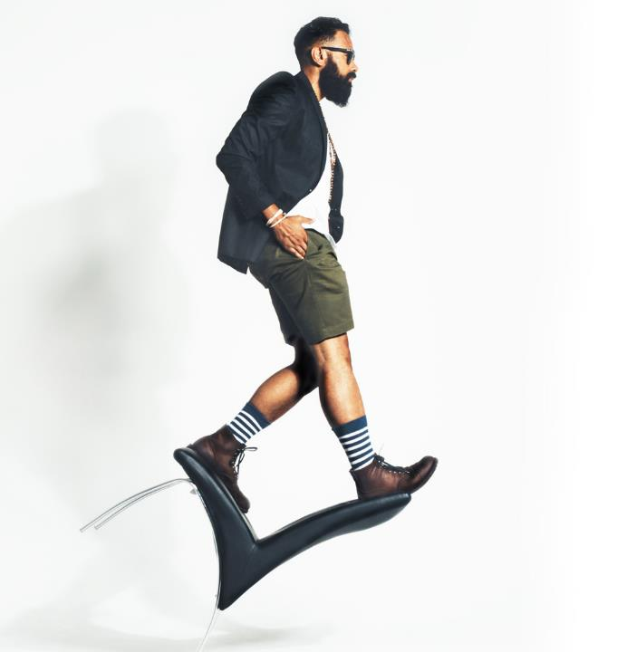
Influencer Idea
Your Campaign Objective
We have seen how minimalist watches like MVMT and Daniel Wellington Food or even hipster streetwear Pestle and Mortar & Stoned and Co have utilized influencers on Instagram to create brand affinity.
Can we replicate that formula for your campaign?
It focuses on engaging an army of micro-influencers to promote your campaign during the time you wish.
The aim of this undertaking to put your campaign at the top of the minds of people.
© SushiVid SDN BHD

Slide 4

Audience Target
Choosing influencer is not just about their reach, it is more about how engaged and relevant they are to the brand they are promoting.
18 – 35 year olds.
Female - Targeted
Bachelor’s Degree holder
© SushiVid SDN BHD

Slide 5
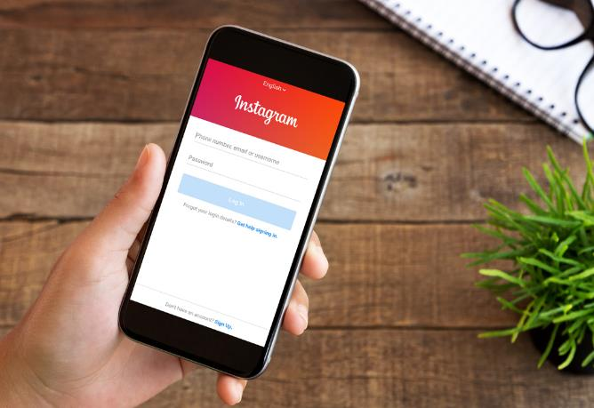
Instagram Buzz
Get small Instagrammers to post 1 -2 Instagram pictures
Collaborate with 20-30 of them to snap a picture of them doing something (i.e picture at concourse area with festival decorations or specific shop like massage, or bar)
Get Instagram with 15k followers and below.
© SushiVid SDN BHD

Slide 6
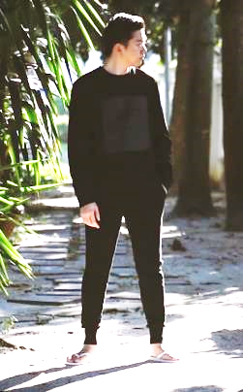
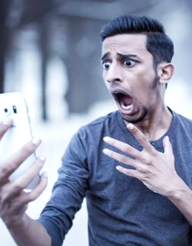

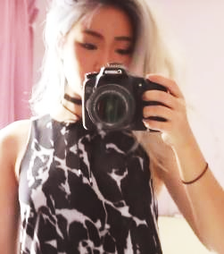
YouTube - Vlog
Supplementary content to go with the main idea
Vlog: YouTubers to spend all day at X Mall.
This is to showcase the things visitors can do/buy.
Videos title example, “Day out with my homies” All expenses paid by X Mall.
Video Example:
@farhankapor
@tianchad
@jessicachaw
@adlinaanis
© SushiVid SDN BHD

Slide 7
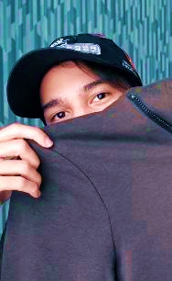
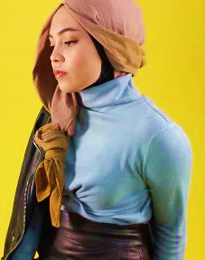
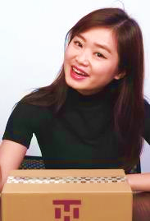
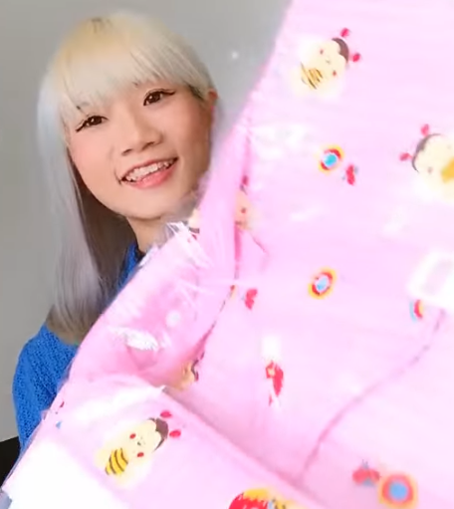
Youtube - Haul
Supplementary Idea – Shopping Haul
Shopping Haul – Get one/two beauty/fashion YouTubers to shop.
This video will basically show the things you could buy at the shopping mall.
Video title example: “My entire outfit was bought in this mall!”
Video example:
@lissapissa
@ezzat.eddy
@arisachow
@thenatstory
© SushiVid SDN BHD

Slide 8
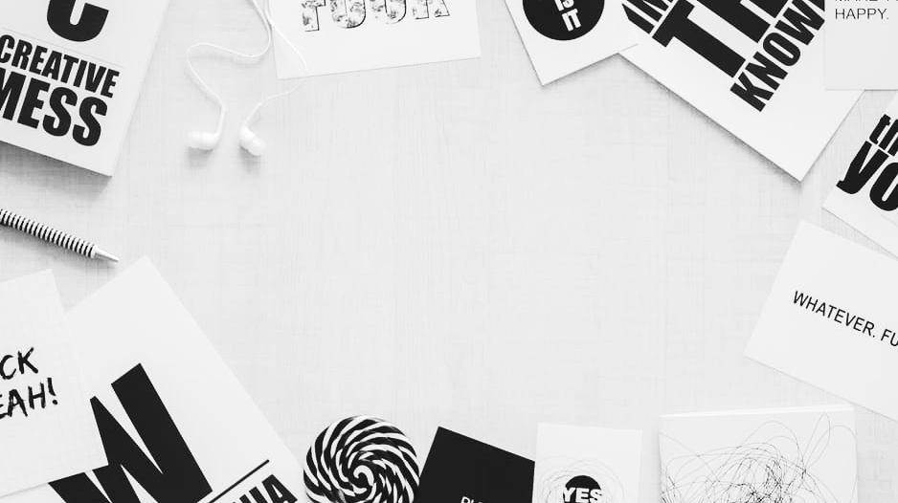
Talent samples
Smaller “Content Creators”
© SushiVid SDN BHD

Slide 9
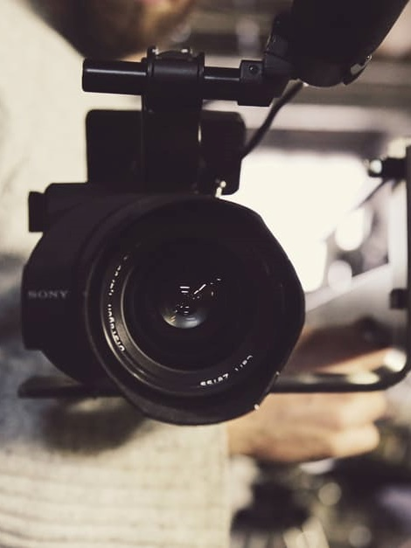
Talents
People who will be promoting!
To create that buzz, we can target the use of smaller Instagrammers and YouTubers.
A win-win situation where the channel can leverage on their popularity to initially grow and get the word out about the channel
They will be filming three videos in one sitting. Videos can be of from different segments
There will be at least two talents in one sitting
Talents will be rotated to see which one resonates well with audience.
© SushiVid SDN BHD

Slide 10
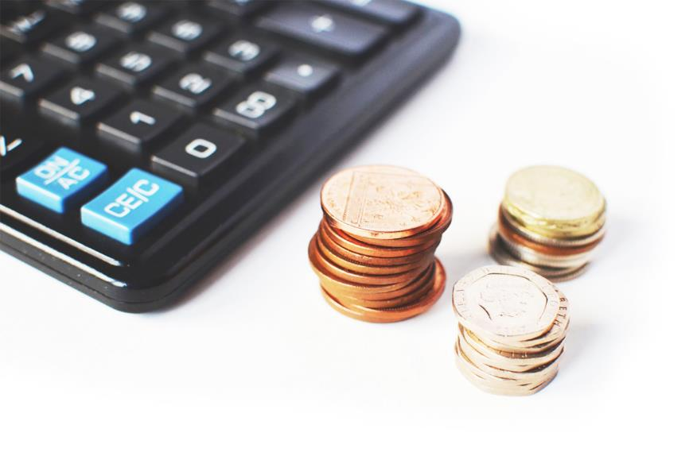
Cost Estimate
Where magic is made
© SushiVid SDN BHD

Slide 11
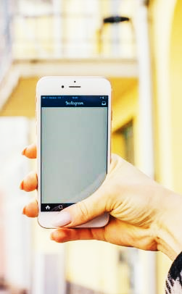
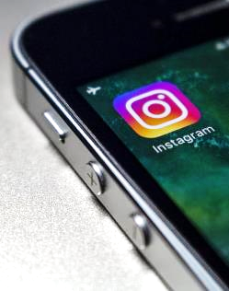
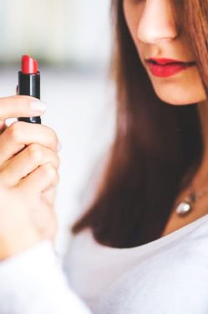

Cost Estimate
Cost Estimate : RM91,000
Cost Breakdown:
30 Instagrammers – RM7,000 - RM11,000
Breakdown
10 Instagrammers 10k – 20k followers- RM 300/post
2 post package - RM500
20 Instagrammers 5k – 20k followers – RM200/post
2 post package – RM300
Lifestyle / Beauty YouTuber – RM2,000/content creator – views 4,000
© SushiVid SDN BHD

Slide 12
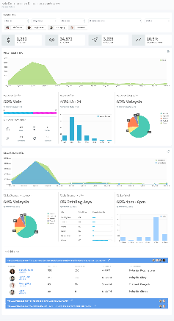
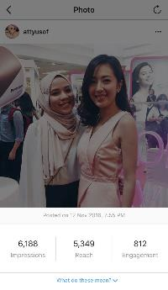
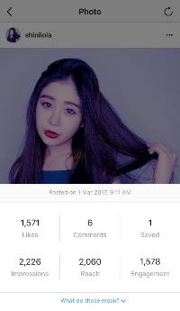
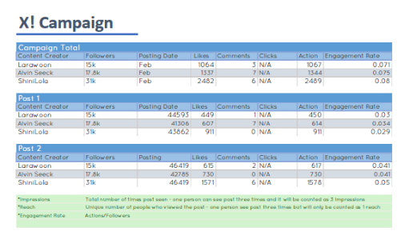
Reporting Style
YouTube and Instagram Reports
YouTube – Figure 1 – Data are updated every three days. Track the performance of a campaign by view distribution, gender, age, and location, and click through rates.
Instagram – Figure 2 - All Instagram posts will be reported twice; their performance in the first, and second week of posting. At the end of the campaign, all post performance will be collated into whole campaign report.
If Instagrammer has Instagram Insights. That will be provided.
Figure 1
Figure 2
© SushiVid SDN BHD

Slide 13
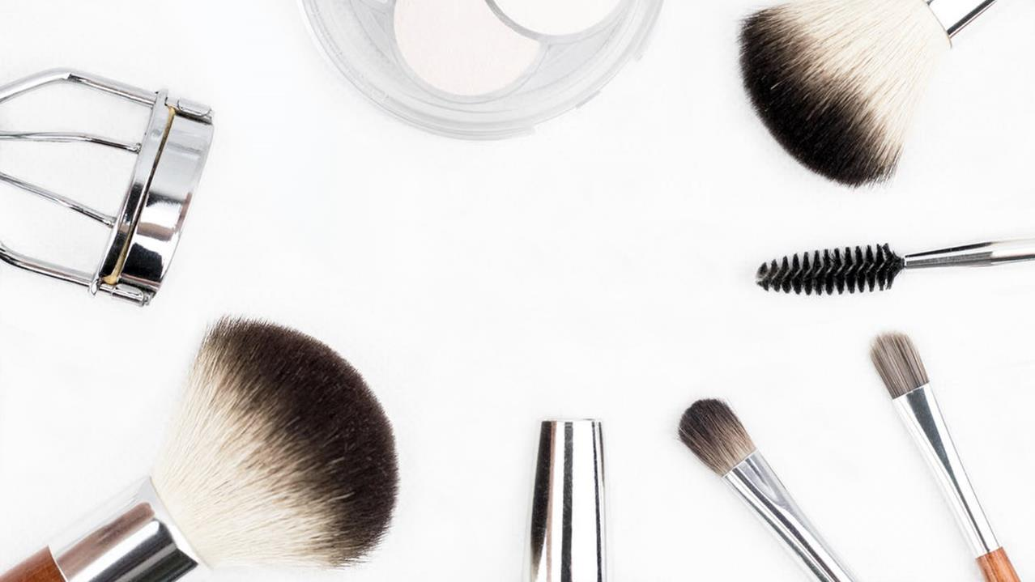
THE END
© SushiVid SDN BHD

