Slide 1
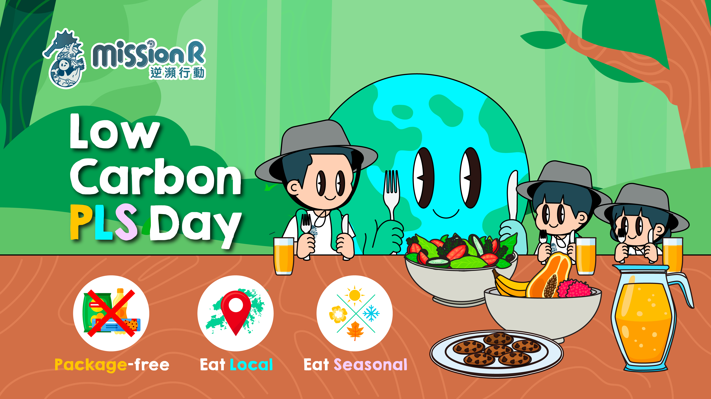

Slide 2
Content
Food Carbon Footprint (Food CF) P.3-6
Package Free P.7-14
Eat Local P.15-20
Eat Seasonal P.21-26
Activities Suggestion P.27-34
Reference P.35-36

Slide 3









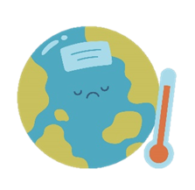



Global Carbon Emission
Food CF
City’s Carbon Emission Ranking
Seoul
Guang Zhou
New York
Hong Kong
Carbon Emission Impact
Global Warming
Reduce biodiversity
Reduce habitat
Notes:
City’s carbon emission ranking
A study from Norwegian University of Science and Technology has ranked world cities by their carbon emission. Seoul has the highest carbon emission among 13,000 cities, emit 276 million tons of carbon per year. Guangzhou has the second highest carbon emission, emit 270 million tons of carbon per year. New York has the third highest carbon emission, emit 234 million tons of carbon per year. Hong Kong has the fourth highest carbon emission, emit 209 million tons of carbon per year. The carbon emission from the top 100 cities on the list has accounted for 18% of world carbon footprint which show the global carbon emission is critical.
What is the impact of carbon emission to human and environment?
Although carbon emission won’t directly affect human, but it affects climate and environment. The concentration of greenhouse gases increases due to carbon emission from burning fossil, land reclamation and industrial development. As a result, the excessive greenhouse gases in atmosphere will lead to global warming.
The increased average temperature and seawater temperature (global warming) will accelerate the melting of glacier, lead to increased sea level and submerge of coastal area. Besides, the abnormal precipitation and desertification of sub-topical region will intensify extreme weather such as heat wave, drought, wild fire, flooding and snowstorm which causes the loss of life and property. Global warming not only affect climate, but it also damages the natural environment, reducing the habitat and the biodiversity.
Reference：
Global Gridded Model of Carbon Footprints (GGMCF) <https://www.citycarbonfootprints.info/>
Carbon emission does not directly affect human but it does to climate and environment
<https://www.greenpeace.org/taiwan/update/29407/%E4%BB%80%E9%BA%BC%E6%98%AF%E7%A2%B3%E6%8E%92%E6%94%BE%EF%BC%9F%E5%92%8C%E7%A9%BA%E6%B1%A1%E6%9C%89%E4%BB%80%E9%BA%BC%E4%B8%8D%E5%90%8C%EF%BC%9F%E7%82%BA%E4%BB%80%E9%BA%BC%E6%82%A8%E6%88%91%E9%9C%80/#:~:text=%E7%A2%B3%E6%8E%92%E6%94%BE%E9%9B%96%E4%B8%8D%E6%9C%83,%E5%8D%BB%E5%BD%B1%E9%9F%BF%E6%B0%A3%E5%80%99%E8%88%87%E7%92%B0%E5%A2%83&text=%E7%95%B6%E5%B9%B3%E5%9D%87%E6%B0%A3%E6%BA%AB%E5%92%8C%E6%B5%B7%E6%B4%8B,%E7%9A%84%E7%94%9F%E5%91%BD%E8%88%87%E8%B2%A1%E7%94%A2%E6%90%8D%E5%A4%B1%E3%80%82>

Slide 4
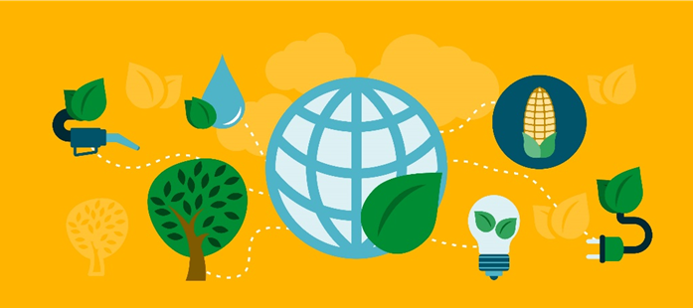
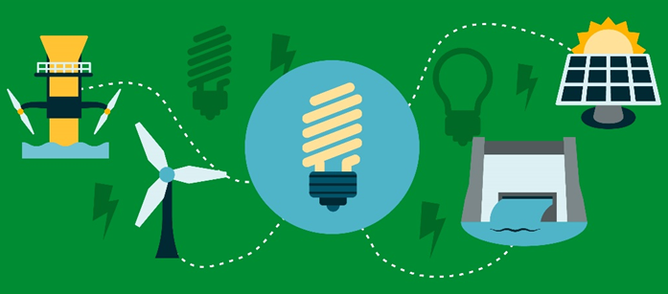
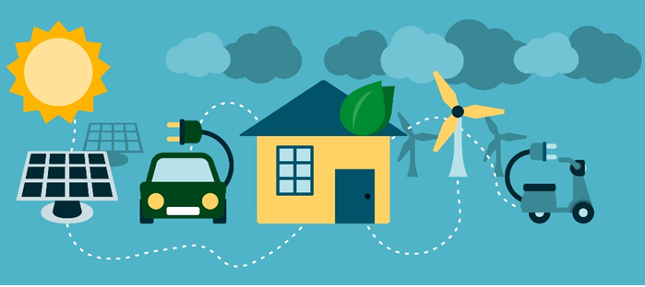
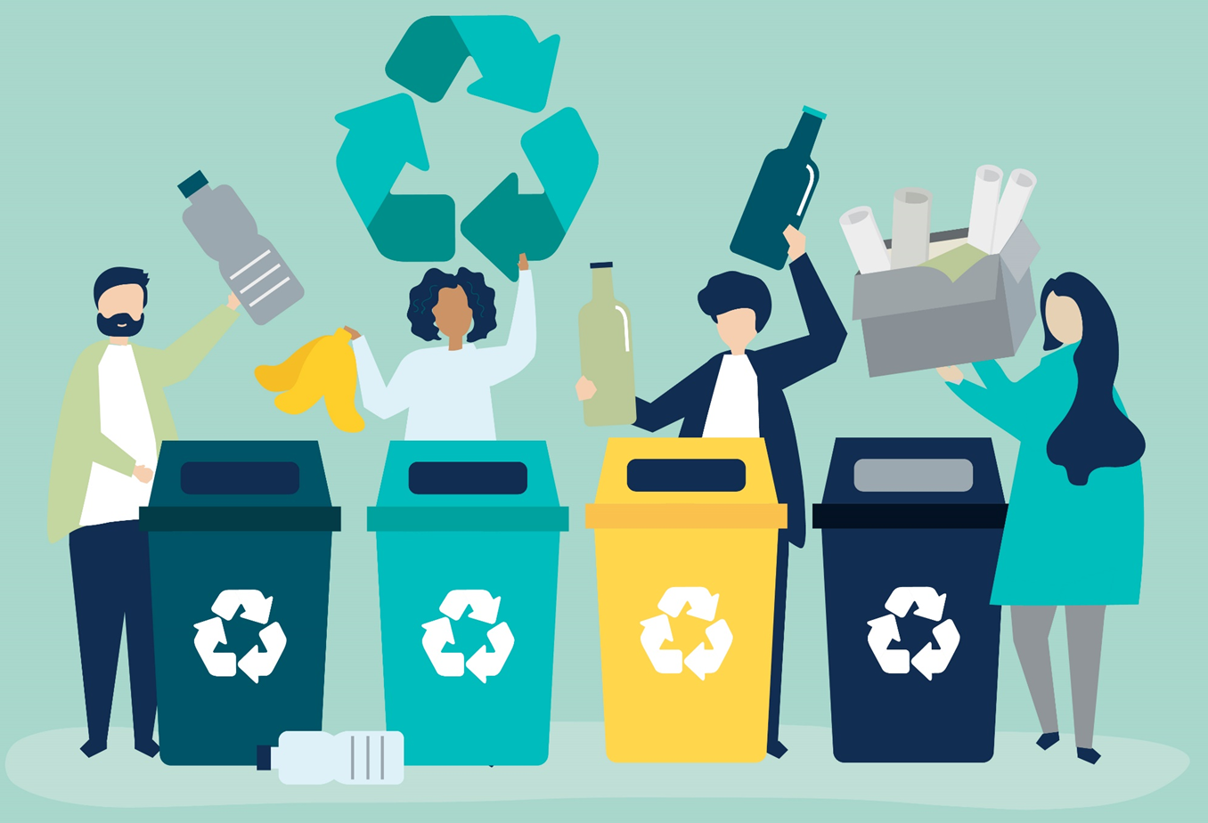
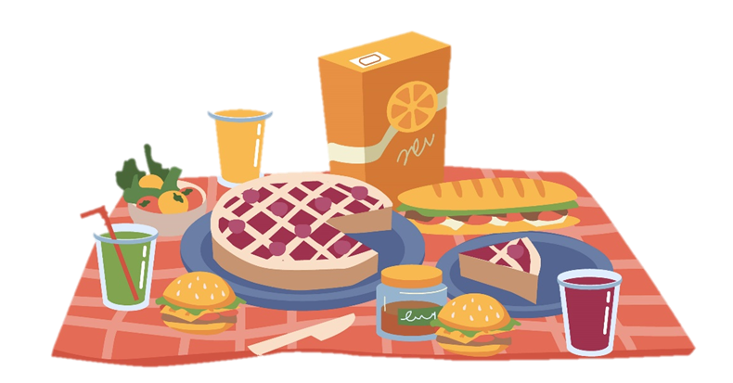
Food CF
Hong Kong’s 2050 Carbon Neutrality Goal
Goal: Reduce Hong Kong’s carbon emission by 50% before 2035 compared to 2005 levels
Four Carbon Neutrality Strategies
Net-zero Electricity Genration
Energy Saving and Green Building
Green Transport
Waste Reduction
Does food produce
carbon emission?
Notes:
Hong Kong’s 2050 Carbon Neutrality Targets
​The Government today (October 8) announced Hong Kong's Climate Action Plan 2050, setting out the vision of "Zero-carbon Emissions‧Liveable City‧Sustainable Development", and outlining the strategies and targets for combating climate change and achieving carbon neutrality. The decarbonisation target is to reduce Hong Kong's carbon intensity by 65 per cent to 70 per cent by 2030 using 2005.
The four major decarbonisation strategies in Hong Kong's Climate Action Plan 2050 cover the following targets and measures:
1) Energy saving and green buildings: Reduce the overall electricity consumption of buildings through promoting green buildings, improving buildings' energy efficiency and promoting a low-carbon lifestyle. The goal is to reduce the electricity consumption of commercial buildings by 30 per cent to 40 per cent and that of residential buildings by 20 per cent to 30 per cent from the 2015 level by 2050, and to achieve half of the above targets by 2035.
2) Net-zero electricity generation: Cease using coal for daily electricity generation; increase the share of renewable energy in the fuel mix for electricity generation to 7.5 per cent to 10 per cent by 2035, and to 15 per cent subsequently; and try out the use of new energy and strengthen co-operation with neighbouring regions to achieve the long-term target of net-zero electricity generation before 2050.
3) Green transport: Achieve the long-term target of attaining zero vehicular emissions and zero carbon emissions in the transport sector before 2050, through the electrification of vehicles and ferries, development of new-energy transport and measures to improve traffic management. The Government will cease the new registration of fuel-propelled and hybrid private cars in 2035 or earlier. Apart from promoting electric buses and commercial vehicles, the Government also plans to collaborate with the franchised bus companies and other stakeholders in the next three years to test out hydrogen fuel cell electric buses and heavy vehicles.
4) Waste reduction: To achieve the long-term target of carbon neutrality in waste management before 2050, the Government will strive to develop adequate waste-to-energy facilities by 2035, so as to move away from reliance on landfills for municipal waste disposal. The Government will also further promote waste reduction and recycling, and expects to implement waste charging in 2023 and regulate disposable plastic tableware in phases from 2025 onwards.
Those strategies seem far from our daily life, so how can we reduce our carbon emission?
Most people focus on reducing electricity consumption and often neglect food miles. Thus, we should learn more about food miles and think of a solution in reducing food carbon emission.
Reference：
GOVERNMENT ANNOUNCES HONG KONG'S CLIMATE ACTION PLAN 2050<https://ecobiz.wwf.org.hk/zh/hkcap2050>
What is Carbon Neutrality, Net Zero Emissions? How can Hong Kong achieve Carbon Neutrality?
<https://www.greenpeace.org/hongkong/issues/climate/update/38072/%E7%A2%B3%E4%B8%AD%E5%92%8C%E3%80%81%E6%B7%A8%E9%9B%B6%E6%8E%92%E6%94%BE%E6%98%AF%E4%BB%80%E9%BA%BC%EF%BC%9F%E9%A6%99%E6%B8%AF%E5%A6%82%E4%BD%95%E9%81%94%E6%88%90%E7%A2%B3%E4%B8%AD%E5%92%8C/>

Slide 5





Food Carbon Footprint
Food CF
Carbon Footprint (CF)
Amount of carbon emission that generated directly or indirectly from a product.
Extraction of raw
material
Processing & package
Transportation & Distribution
Acquisition &
Consumption
Disposal of
Food waste
Notes:
The lifecycle of food
The lifecycle of food refers to the various stages that food goes through from production to disposal, and the direct and indirect carbon emissions generated at each stage are also calculated in the food's carbon footprint.
1. Raw Material Extraction:
The carbon footprint of raw material extraction includes the carbon emissions of production and cultivation processes of food. This includes the carbon emissions generated during land preparation, irrigation, fertilization, pest control, and harvesting.
2. Processing:
The carbon footprint of processing and packaging includes the carbon emissions from cutting and packaging processes of food. If different materials are used for packaging, the carbon emissions from the production of the package are also included in the food's carbon footprint.
3. Transportation and Distribution:
The carbon footprint of transportation and distribution refers to the carbon emissions generated from transporting food from the place of production to the hands of consumers. The distance and type of transportation are the main factors influencing the carbon emissions.
4. Purchase and Consumption:
The carbon footprint of purchase and consumption includes the process of carbon emissions of purchasing and cooking , such as using refrigerators and cooking equipment.
5. Food Waste Management:
The carbon footprint of food waste management mainly comes from the carbon emissions generated from the decomposition of food waste.
Reference:
“A comprehensive review on carbon footprint of regular diet and ways to improving lowered emissions”, <https://www.sciencedirect.com/science/article/pii/S2590123023001810>

Slide 6
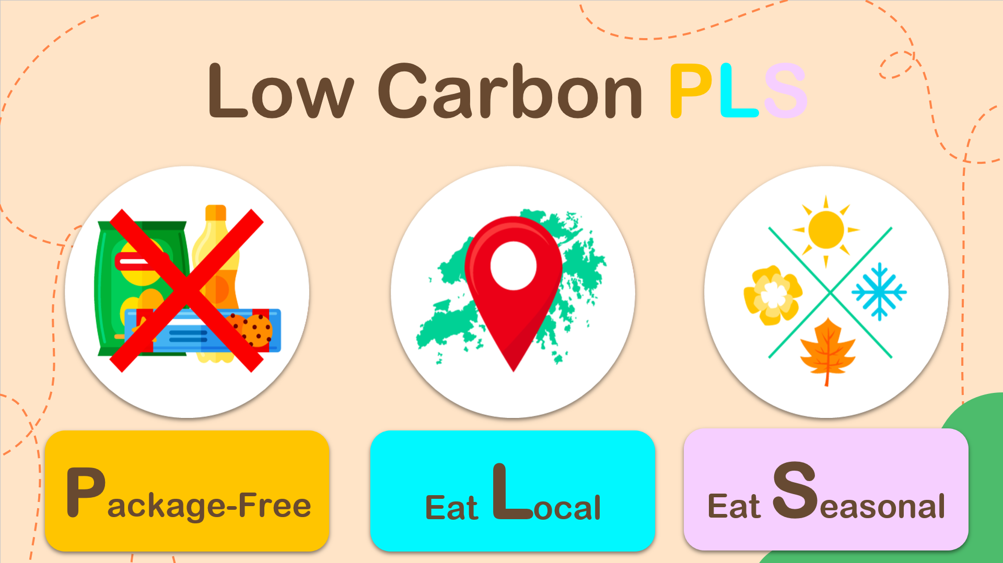
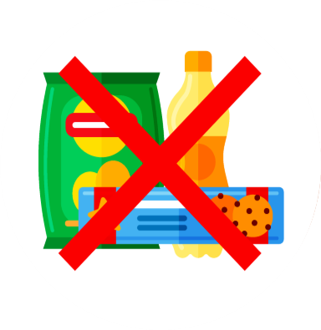

Low Carbon PLS
Package-Free
Eat Local
Eat Seasonal

Slide 7
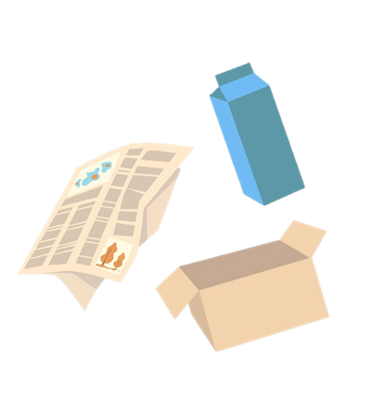
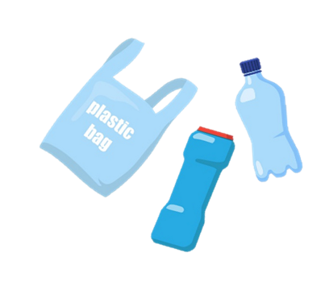
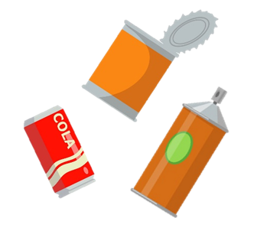
Common Types of Packaging
Package Free
Paper
Metal
Plastic
Notes:
Common Package Material
Paper
For example: Corrugated paper box
Environmental impact: Manufacturing of paper may cause deforestation, high energy consumption that leads to high carbon emissions, wastewater discharge that leads to water pollution.
Metal
For example: Aluminum foil pan/ tray for cooked food
Environmental impact: Raw material mining may lead to deforestation, biodiversity loss or soil erosion, the processing is energy-intensive that leads to high carbon emissions.
Plastics
For example: distilled water container
Environment impact：Most plastics are made from fossil fuels. Extraction of fossil fuel may lead to deforestation or fossil fuel leakage, the process is energy-intensive that leads to high carbon emissions, marine and soil contamination caused by microplastics, burning of plastics leads to toxic substances and air pollutant emissions.
Reference：
Practical Guides on packaging reduction and management – supermarket and grocery stores sector
<https://www.wastereduction.gov.hk/sites/default/files/resources_centre/Practical_Guides_on_Packaging_Reduction_And_Management-Supermarkets_and_Grocery_Stores_Sector_ENG.pdf>

Slide 8
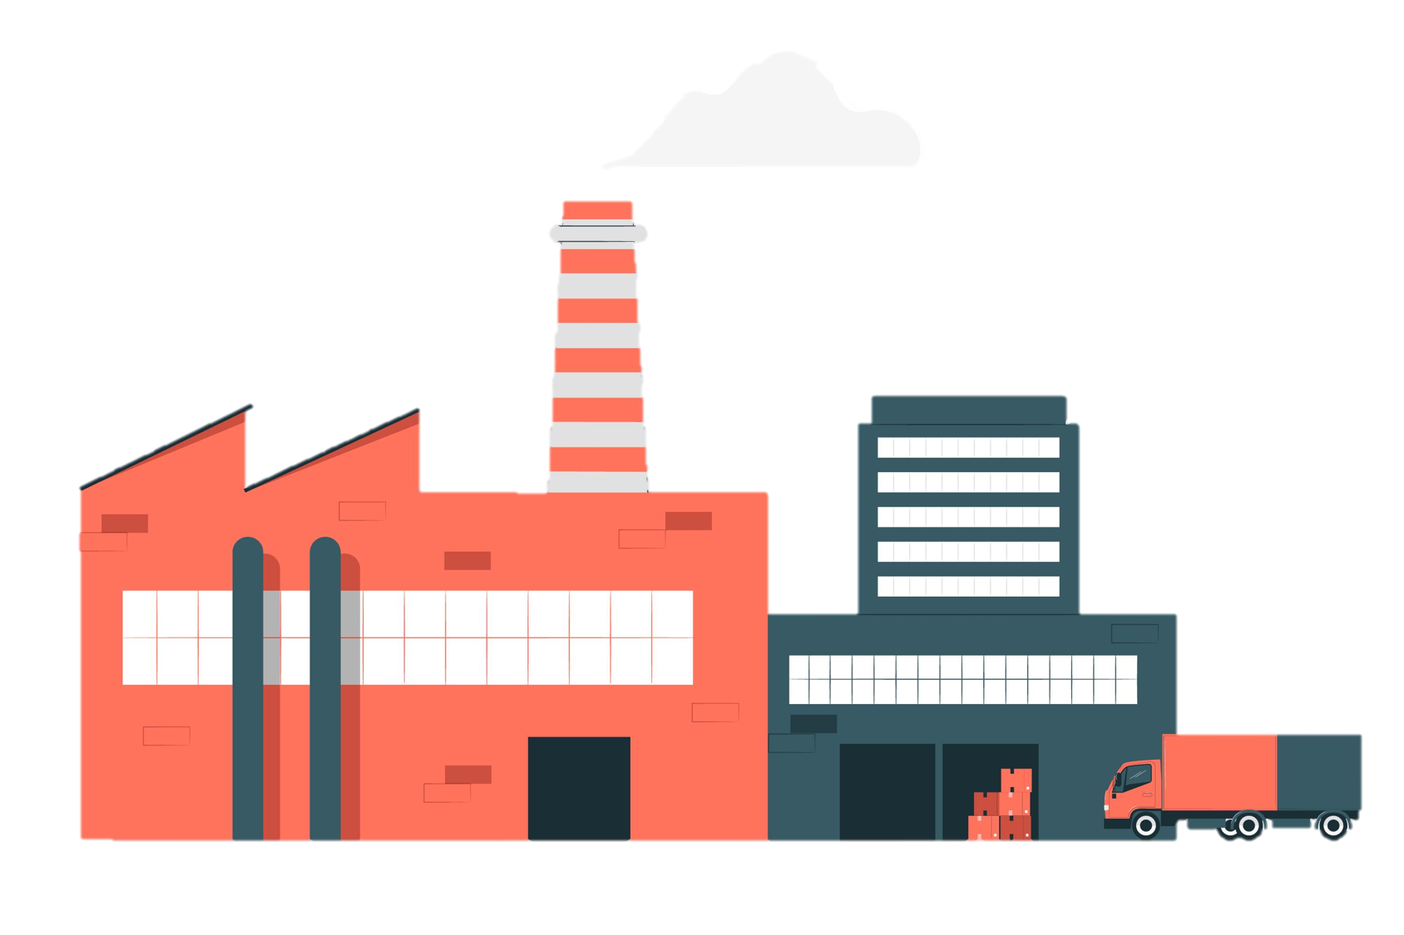


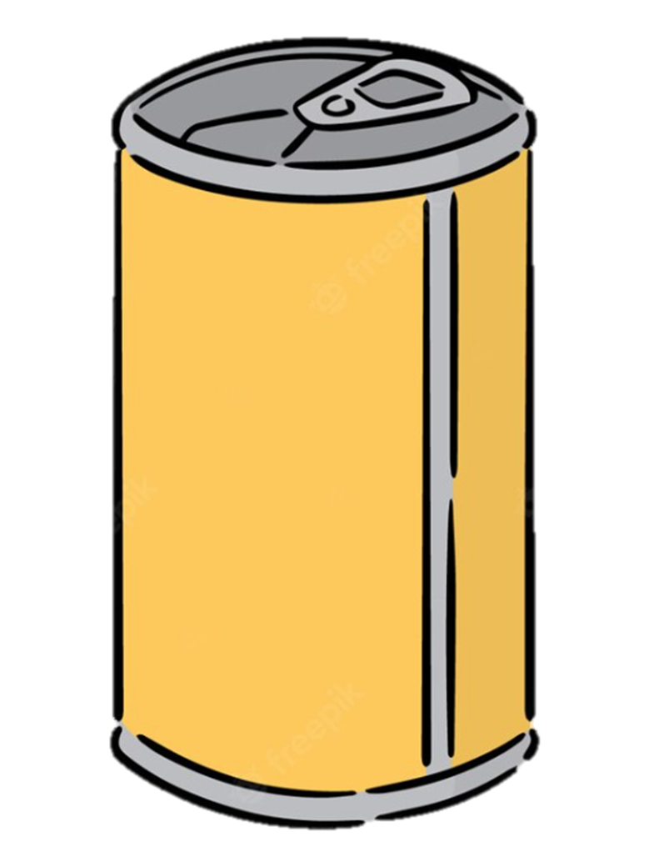

Carbon Emission of Package Production
Package Free
Packaging (per kg) | Carbon Emission( = 1 kg)
Notes:
Will packaging production produce carbon emission?
The process of package production include extraction of raw material, processing & package, transportation and distribution. These activities will emit different extend of carbon dioxide and greenhouse gases, hence increase carbon footprint;
Different package production emit different carbon emission, the chart above compared the carbon emission of different food packaging; The package production & carbon emission take 1kg as unit.
Paper: 0.94kg carbon emissions per 1kg package production
Plastics: 1.16kg carbon emissions per 1kg package production
Metal: 2.32kg carbon emissions per 1kg package production
Reference:
What is the carbon footprint of food packaging? < https://www.teorra.info/blog/what-is-the-carbon-footprint-of-packaging>

Slide 9
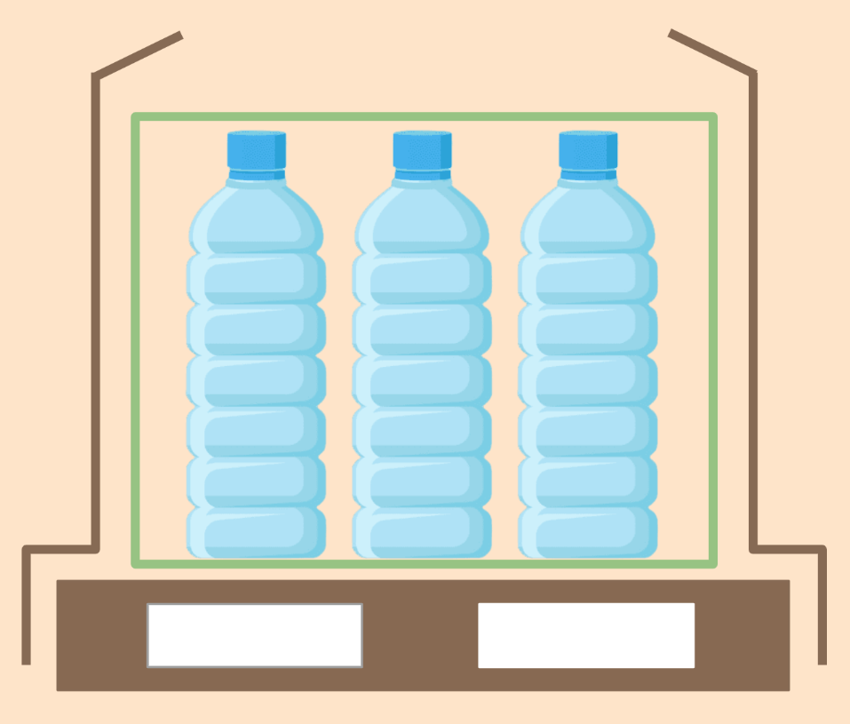
Food Packaging
Package Free
Secondary Packaging
E.g.: Cling wrap、Shrink film、Plastic trays
Tertiary Packaging
E.g.: Cardboard, Stretch fillm, Plastic crates, Wooden pallets
Primary Packaging
E.g.: Plastic bottles, Metal cans, Paper cartons
Service PackagingE.g.: Plastic shopping bags, Takeaway containers
Notes:
Food Excessive Packaging
Food package refers to products made of materials with different nature that are used for containment, protection, handling, delivery and presentation of goods. It also includes the process from raw materials to the user or the consumer. Packaging mainly comprises primary packaging, secondary packaging, tertiary packaging and service packaging.
Primary packaging: Packaging conceived so as to constitute a sales unit to the final user or consumer at the point of purchase
Secondary packaging: Packaging conceived so as to constitute at the point of purchase a grouping of a certain number of sales units whether the latter is sold as such to the final user or consumer or whether it serves only as a means to replenish the shelves at the point of sale. It can be removed from the product without affecting its characteristics.
Tertiary packaging: Packaging conceived so as to facilitate handling and transport of a number of sales units or grouped packaging in order to prevent damage during physical handling and transportation.
Service packaging: Packaging conceived so as to facilitate the delivery of sales units and for the containment of sales units at point of sale.
Different packagings used for maintaining hygiene of food, easy for store and transportation. However, unnesscary and excessive packaging existed.
Reference:
Practical Guides on Packaging Reduction And Management
<Practical Guides on Packaging Reduction And Management – Supermarkets and Grocery Stores Sector (wastereduction.gov.hk)>

Slide 10

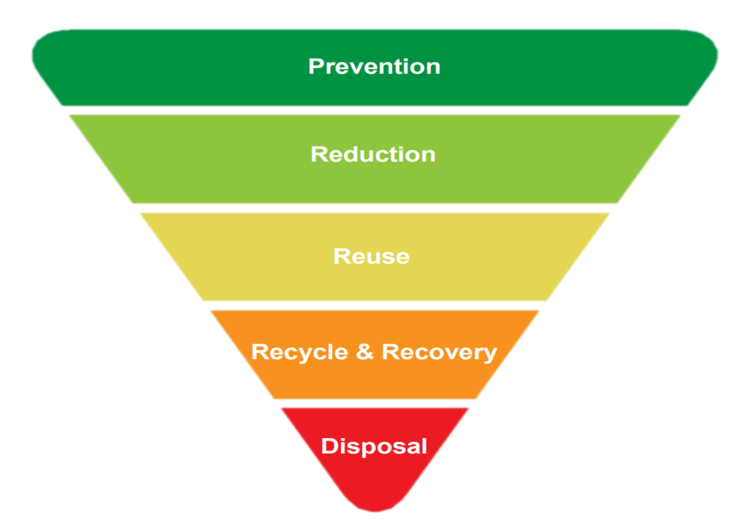
Low Carbon Tips
Package Free
Package Free
(Shop Naked)
Environmental-Friendly Purchase Method
Selective Purchase
Notes:
Low Carbon Tips
The “waste management hierarchy” (above) is a globally recognised conceptual framework designed to guide and prioritise waste management decision and is a useful tool to consider different strategies for reducing packaging. Measures moving up along the waste hierarchy would save costs, raw materials, natural resources and energy and reduce the overall impact on the environment.
Higher-level measures include prevention and reduction;
Prevention refer to avoid the use of non-essential materials/ components where possible.
Reduction refers to reduce the amount (e.g. size, thickness or weight) of packaging material used and adopt environmentally-friendly alternatives. In low carbon diet, environmental friendly purchase method and selective purchase is the example of reduction.
Reference:
Practical Guides on Packaging Reduction And Management
<Practical Guides on Packaging Reduction And Management – Supermarkets and Grocery Stores Sector (wastereduction.gov.hk)>

Slide 11

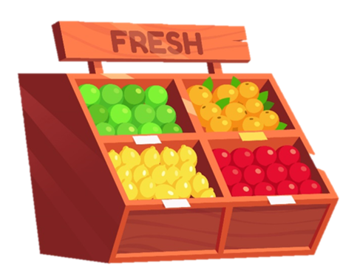




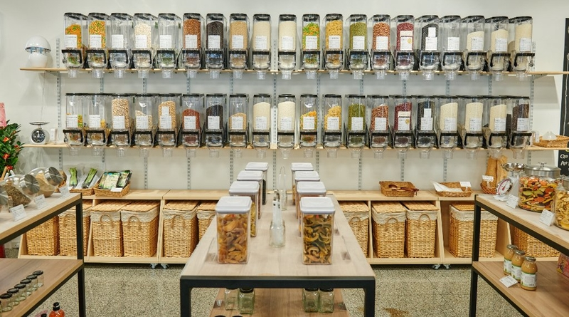
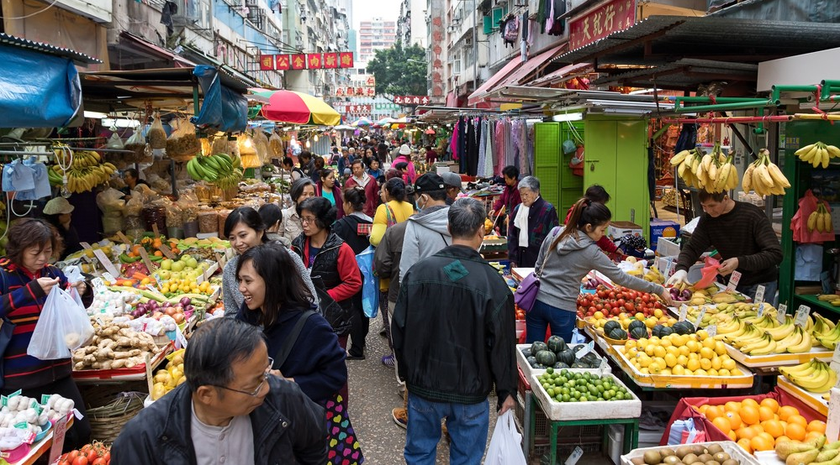

Package Free
(Shop Naked)
Package Free
Supermarket
Purchase package free product
Bring your own bags
E.g.
Reduce package wastes
Unpacked Store
Wet Market
Purchase on demand, reduce wastes
Notes:
What is shop naked?
Shop naked refer to customer have to prepare reusable container to purchase food and daily necessities. The concepts of shop naked is prevalent in Hong Kong. Reducing waste at the source is more effective and significant, so they are willing to shopped naked and reduce disposable plastic packaging. Unpacked store and wet market are the common places of shop naked in Hong Kong. There are about 26 unpacked shops and 6 unpacked online shop in Hong Kong.
Benefits of shop naked:
More environmentally friendly and reduces the production of packaging waste
Customers carry their own container for shopping, reduce unnesscary disposable waste.
Charged based on its quantity and reduce waste
The format of unpack provide customer to purchase freely to reduce waste. For example, $1 proportion of food can purchase in a unpacked shop.
Reference:
Analyzing the packaging strategy of packaging-free supermarkets <https://www.sciencedirect.com/science/article/abs/pii/S0959652621002687>
2023 Hong Kong environmental shop naked guild (with map) <https://www.greenpeace.org/hongkong/issues/plastics/update/32953/港九新界有齊>

Slide 12




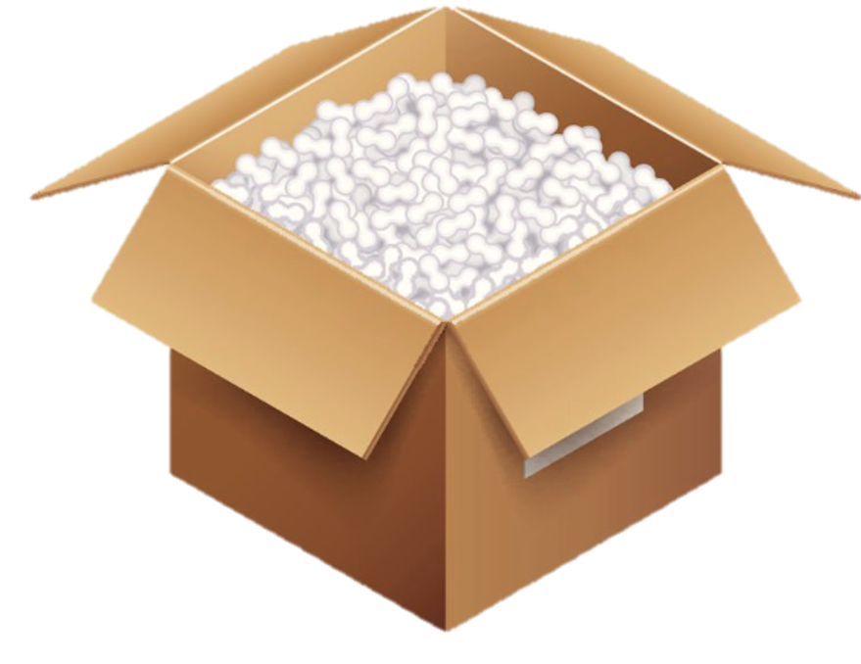



Environmental-Friendly Purchase Method
Package Free
Store
Online Store
4.8 times more packaging than normal store
Package Amount | Primary Packaging | Excessive Packaging + Cushioning Material
Delivery Method | Pick-up | Extra Delivery
Annual Duct Tape Consumption can would around the earth 1077 times.
Notes:
Which store is more environmental-friendly?
With the aid of technology, online shopping is prevalent in Hong Kong. In fact, different purchase method lead to different emission of carbon footprint. Purchase with an environmental friendly method could reduce carbon footprint.
Differences of store and online store with different form of packaging:
Store could perform primary packaging or even no package. Compare with online shopping, food are commonly with multiple packagings and protective materials. Compare with the massive transport of the same category of product, particular transportation require more protection to maintain the quality of food. A research in Korea stated that the packaging of online store is 4.8 more than a store. To conclude, store require fewer packaging than online store, purchasing in store could help reduce carbon footprint.
Multiple packaging: primary packaging, secondary packaging, tertiary packaging, service packaging
Cushioning materials: plastic foam, inflatable plastic bag, bubble wrap
Besides, the transportation of store and online store to customers are slightly different. In store, customers could visit the store in person, but online store could not. Online store require transportation for delivering food to customers. Online store pack small packages into a large package, and transport to customer by air, ship and land.
To conclude, purchasing in store generate less carbon footprint, we could choose store instead of online store.
Fun Fact
According to the estimation of State Post Bureau of China in 2012-2017, total number of courier rapidly increase from 5.6 million to 40.06 billion pieces. By estimation, the total number of courier could increase to 70 billion pieces in 2020. Also, the annual duct tape consumption could wrap around the earth 1077 times.
Reference:
Is online shopping packaging waste a threat to the environment? <https://www.sciencedirect.com/science/article/abs/pii/S0165176522000684>
遠離網購更環保？ 過度包裝、碳足印、環保政策逐一拆解 <https://www.greenpeace.org/hongkong/issues/health/update/28669/遠離網購更環保？-過度包裝、碳足印、環保政策逐/>

Slide 13

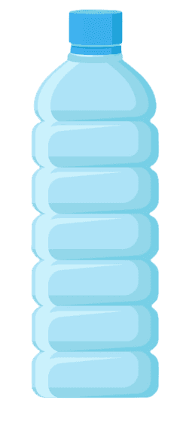
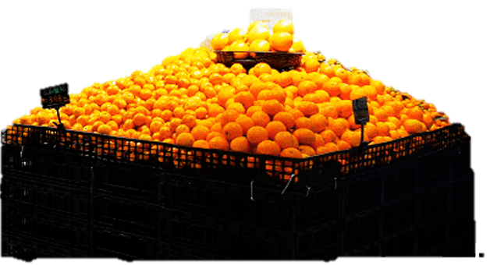
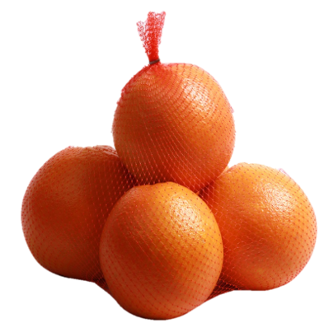


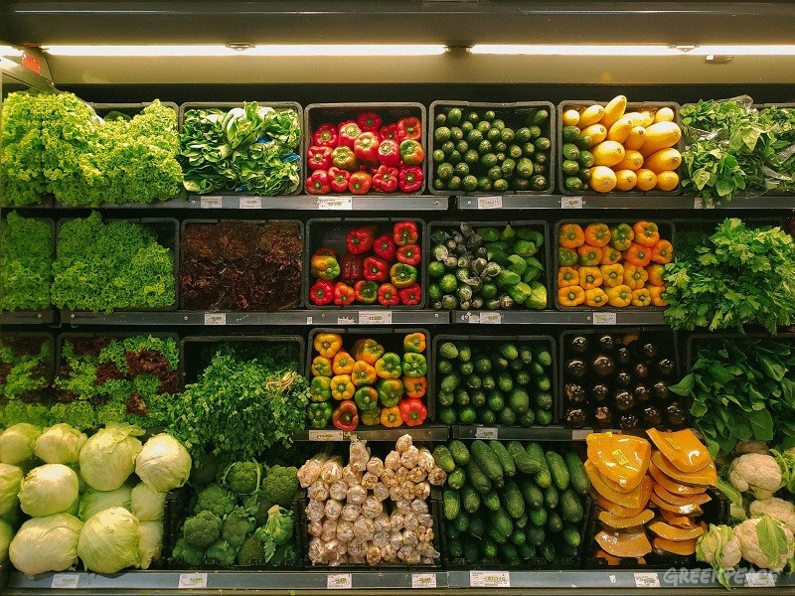
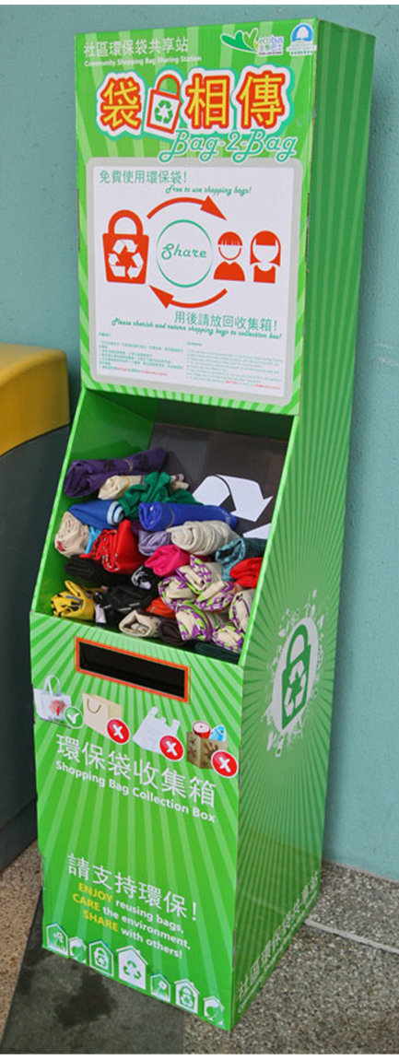
Technique of Selective Purchase
Package Free
2
Choose product with no label
1
Choose product with less packaging
No-plastic Vegetables Session
Shared Recycle Bag Station
3
Choose Environmental-Friendly Supermarket
Notes:
Technique of selective purchase
Main 3 techniques:
Choose product with less packaging
As supermarket do not have a clear guideline for packaging, different supermarket could provide different packaging for the same product. So we could choose product with less packaging.
Take orange as an example.
We should purchase orange with no packaging (shop naked)
Purchase with less packaging (Pack with a bag)
Purchase with more packaging (Pack with a box and protective materials)
Choose product with no label
There are different brands of bottled drinks include labels. Labels will produce extra carbon footprint. To reduce carbon footprint, we could purchase product with no label.
Choose environmental friendly Supermarket
Environmental friendly Supermarket provide unpacked food for shop naked. In 2019, Greenpeace launched a cosign “Let’s choose a no plastic supermarket”. Parknshop start with a no-plastic vegetables session with the support of citizens, and set up station in universities. Unpacked facilities help reduce carbon footprint, facilities include: No-plastic vegetables session and shared recycle bag station
No-plastic vegetables session: All vegetables and fruit in this area are unpacked, customers could choose freely
Shared recycle bag station: Provide free shopping bag for customers without a bag, reduce the use of plastic bag
Reference:
24,000人聯署有成！百佳2030年走塑承諾睇真啲<https://www.greenpeace.org/hongkong/issues/plastics/update/26194/24000人聯署有成！百佳2030年走塑承諾睇真啲/>

Slide 14

Low Carbon PLS
Eat Local
Package-Free
Eat Seasonal

Slide 15

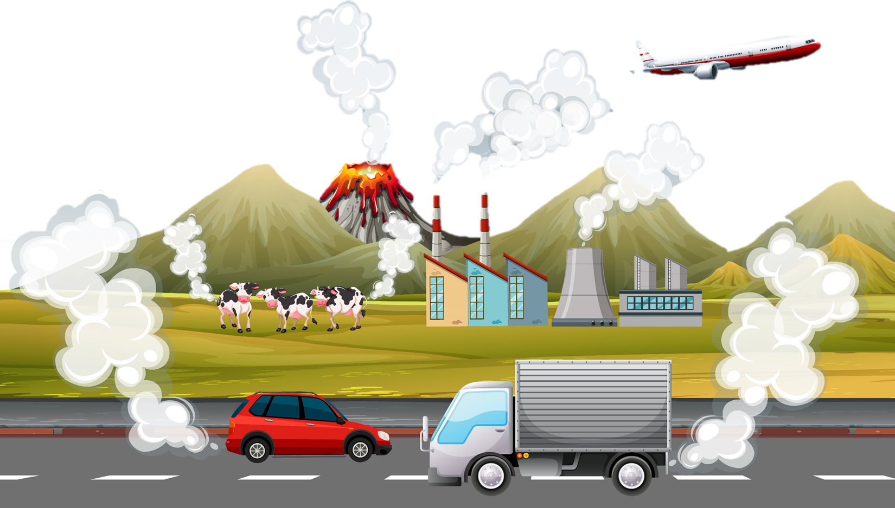



Food Miles Carbon Emission
Eat Local
Food Miles
Food miles is the distance food is transported from the time of its making until it reaches the customer.
Distance
Transport
Food Miles Carbon Emission
Notes:
Food Miles Carbon Emission
Food Mile: The distance that food is transported from the time of its producing until it reaches the consumer.
Food Mile Carbon Emissions: The carbon emissions generated during the process of transporting food from the production point to the hands of consumers.
Formula for Food Mileage Carbon Emissions:
Food Mile Carbon Emissions = Distance x Mode of transportation
Distance: The distance from the production point to the consumption point.
Mode of Transportation: (Air, Rail, Sea, Road)
The further the distance, the higher the food mile carbon emissions.

Slide 16
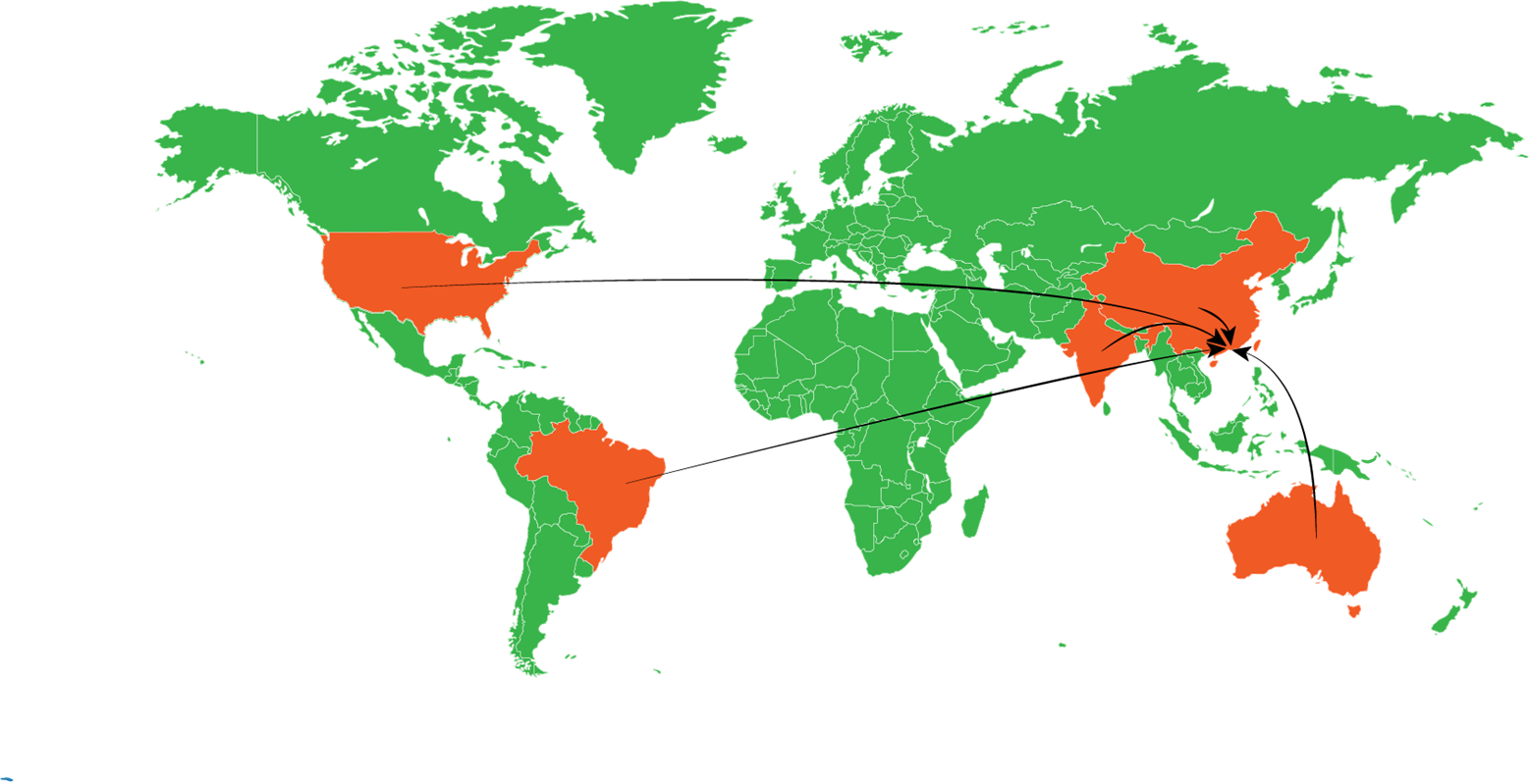






Hong Kong Top 5 Food Import Country
Eat Local
Country | Distance(KM) | Main Import Food
China | 1,974 | Pork, Beef, Vegetables, eggs
United States | 12,329 | Chilled Meat
Thailand | 1,725 | Fruit, Vegetables, seafood
Brazil | 17,999 | Chilled Beef
Australia | 7,386 | Fruit and Meet
China 1,974 Km
United States
12,320Km
Thailand 1,725Km
Brazil 17,999Km
Australia 7,386Km
Over 90% of food are imported in Hong Kong!!!
Notes:
Hong Kong Top 5 Food Import Country
Over 90% of food ingredients in Hong Kong are imported. The top 5 import countries are: China, United States, Thailand, Brazil and Australia.
The main food source comes from mainland China, which provides a significant portion of fresh food demand in the city: 94% of fresh pork, 100% of fresh beef, 92% of vegetables, and 66% of eggs. Hong Kong also imports a large amount of chilled and frozen meat from Brazil, Australia, the United States, and New Zealand. Fresh fruits and vegetables, live and frozen seafood are sourced from Thailand.
Choosing import food ingredients from closer locations results in lower carbon emissions.
Reference:
Hong Kong, China Food Products Imports by country in US$ Thousand 2021
<https://wits.worldbank.org/CountryProfile/en/Country/HKG/Year/LTST/TradeFlow/Import/Partner/by-country/Product/16-24_FoodProd>
10 Ways To Eat More Sustainably In Hong Kong (Besides Consuming Less Meat)
<https://eugreenia.com/blog/2020/1/22/10-ways-to-eat-more-sustainably-in-hong-kong>

Slide 17





Transportation Emssion
Eat Local
Air Transport
Rail Transport
Water Transport
Road Transport
0.02 Kg CO2eq per tonne- kilometer
1.13 Kg CO2eq per tonne-kilometer
0.06 Kg C02eq
per tonne-
kilometer
0.2-0.66 Kg CO2eq per tonne-kilometer
Transporting food by air emits around 50 times as much greenhouse gases as transporting by sea.
Notes:
Transportation Emission
A boat can carry much more food for a given distance than a truck can. To give an informative comparison, we use a metric called ‘food miles’; this is calculated as the distance each transport method covers multiplied by the quantity of food transported (by mass). This gives us a comparison of food miles in tonne-kilometers.
Air Transport: 1.13 kilograms of carbon dioxide-equivalents (CO2eq) per tonne-kilometer emitted by air.
Rail Transport: 0.06 kilograms of carbon dioxide-equivalents (CO2eq) per tonne-kilometer emitted by Rail.
Water Transport: 0.02 kilograms of carbon dioxide-equivalents (CO2eq) per tonne-kilometer emitted by Water.
Road Transport: 0.2-0.66 kilograms of carbon dioxide-equivalents (CO2eq) per tonne-kilometer emitted by Road.
Only 0.16% of food miles come from air travel. Most – nearly 60% – comes by boat.
Transporting food by air emits around 50 times as much greenhouse gases as transporting the same amount by sea.
Reference:
Very little of global food is transported by air; this greatly reduces the climate benefits of eating local
<https://ourworldindata.org/food-transport-by-mode>

Slide 18
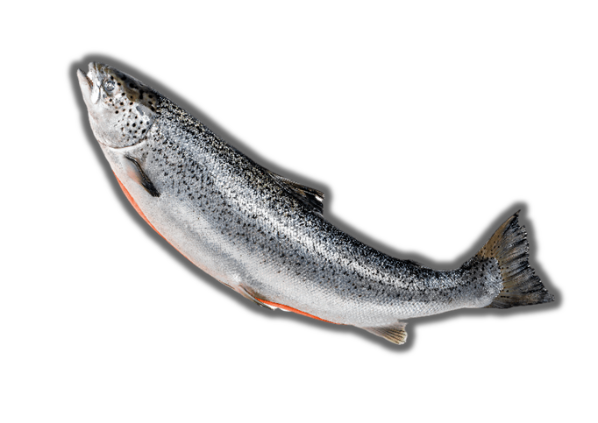
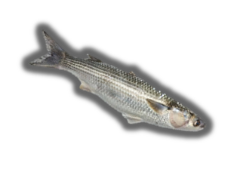




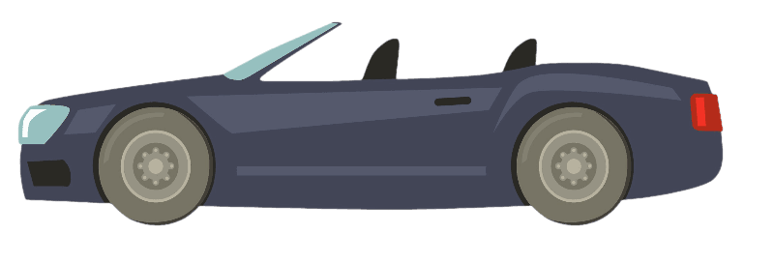
Food Miles:
Reduce Carbon Emission
Eat Local
Norwegian Salmon
Local Seafood
Choosing Local Seafood over Norwegian Salmon can reduce 1.79kgC02 carbon Emission
1.79kgCO2e
Watch streaming service for 4 hours
Drive 7 Kilometer
304 fully charged smartphone
Notes:
Food Miles: Reduce Carbon Emission
Remark:
The calculation is based on a 250g fillet of salmon imported from Norway by air
Only the transportation emission from fishery farms or sites to Hong Kong
Reference:
<Ocean Park_Carbon Savings of Purchasing Local Seafood_Presentation_v1.0>

Slide 19

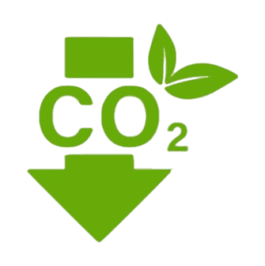

Benefit of Choosing Local Food
Eat Local
Fresher food
Reduce 5 – 17 times of Greenhouse gas
Reduce Waste
Notes:
Benefit of Choosing Local Food
Up to 40% of the nutritional value of fresh produce can be lost during transport and distribution.
Quality Nutrition: season, harvested closer to their peak ripeness, and transported shorter distances are fresher and
more nutritious.
Consuming local produce also significantly reduces transport-related energy consumption – 5-17 times less CO2
emissions than far-flung ingredients.
Decrease Wastage: Buying locally-grown and locally-produced food decreases food loss and wastage during the food
value chain.
Therefore, prioritize in low food miles ingredients and adapt more in local seasonal food have a lesser affect to the environment.
Reference:
STAPLE SCARCITIES- FOOD PRODUCTION TERRITORIALISATION OF HONG KONG
<https://www.iaacblog.com/projects/staple-scarcities-food-production-territorialisation-hong-kong-2/>
Farms in the sky: fewer food miles, less waste, more jobs
<https://hongkongfp.com/2016/01/24/farms-in-the-sky-fewer-food-miles-less-waste-more-jobs/>
8 Reasons To Love The Farm-To-Table Movement PLUS The Complete HK Farm-To-Table Dining List
<https://www.greenqueen.com.hk/the-complete-farm-to-table-hong-kong-restaurants-list/>

Slide 20

Low Carbon PLS
Eat Seasonal
Package-Free
Eat Local

Slide 21
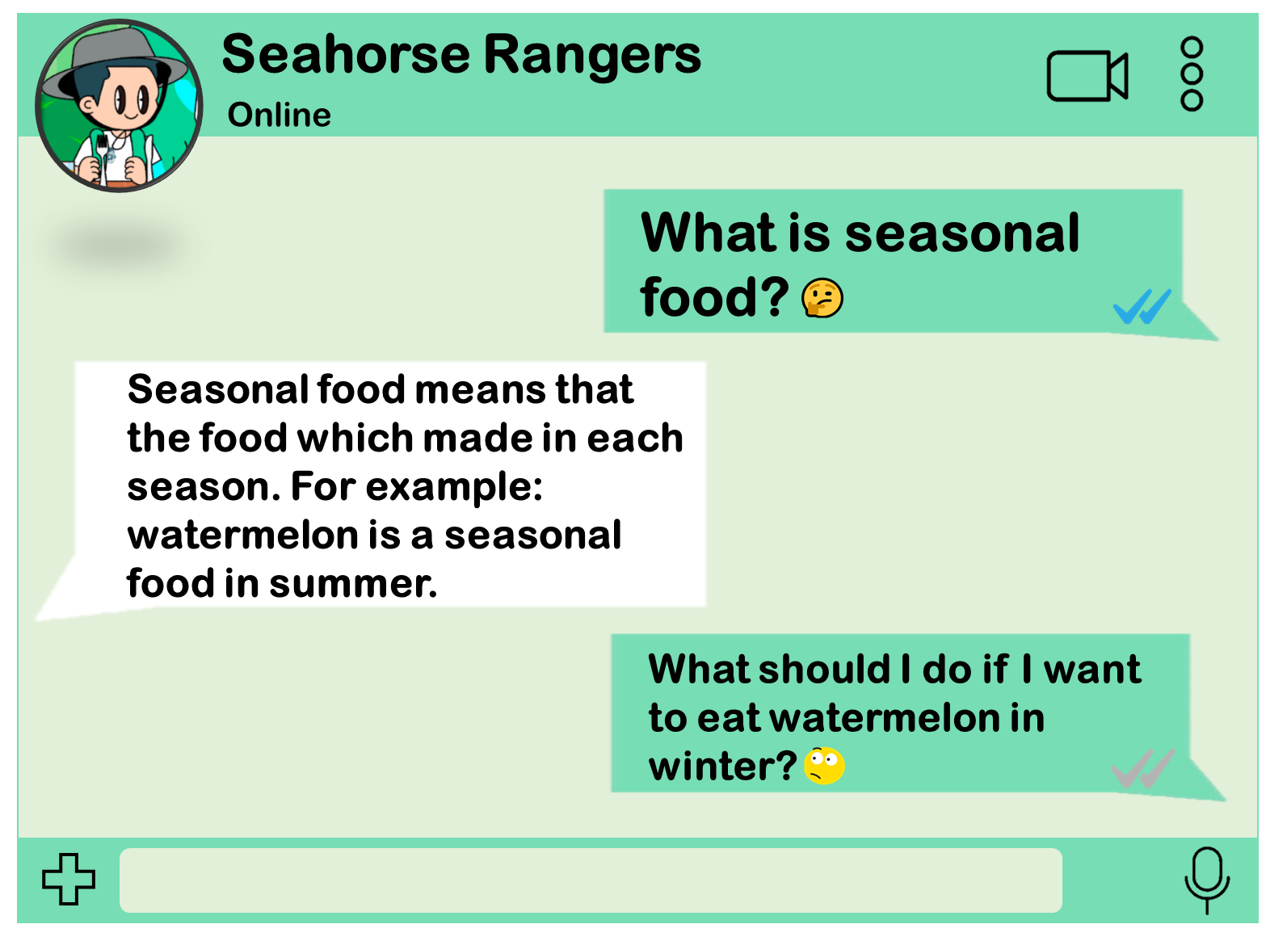

Eat Seasonal
Notes:
Seasonal Food
Seasonal food refers to the food that issuitable for producetion during a specific season in its natural environment.
Reference：
「時令新鮮」, (低碳生活館) “Fresh Seasonal” <https://www.lowcarbonliving.hk/chi/Seasonal.aspx>

Slide 22
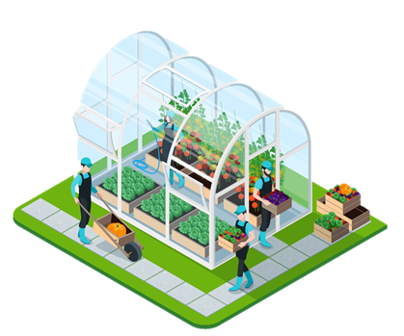
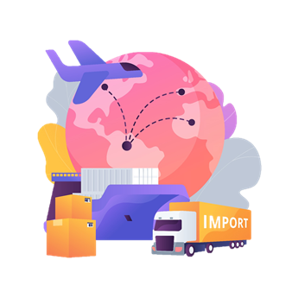
Where does the non-seasonal coming from?
Eat Seasonal
Greenhouse Farming
Imported Food

Slide 23
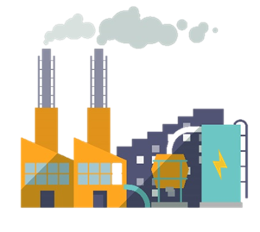


Electricity
Carbon Emission
CF of Greenhouse Farming
Eat Seasonal
More Usage of Heating Equipment
Greenhouse Farming
Carbon Emission during Production and Transportation
More consumption of Synthetic Fertilizer
Notes:
Greenhouse food produce higher carbon footprint
Compared to open-field farming, greenhouse farming produce more greenhouse gases emssion. According to the research from Southwest University, in China, every tonnes of greenhouse vegetables produce around 116 kg more carbob emission, 50 – 80% higher than the open field farming vegetable. More usage of heating equipment and syntheric fertiliser are the two main reasons greenhouse food produce higher carbon footprint.
High energy consumption
Greenhouse farming require heating equipment to maintain its environment which consume large amount of energy and produce carbon emission. During winter or cold weather, the carbon emission will be much more. Therefore, greenhouse food will have higher carbon footprint.
High consumption of synthetic fertiliser
High consumption of synthetic fertiliser in greenhouse farming also contribute to its high carbon footprint. According to the Southwest University ‘research, around 78 % of the carbon emission of greenhouse vegetable are from synthetic fertiliser – nitrogen fertilizer. Using synthetic fertiliser will lead both direct emission and indirect emission such as production and transportation.
Referene：
“Greenhouse gas emissions from vegetables production in China”, (Fen Zhang a, Fabo Liu a, Xiao Ma a b, Guangzheng Guo , Bin Liu , Taihong Cheng , Tao Liang , Weilin Tao , Xinping Chen , Xiaozhong Wang) - https://www.sciencedirect.com/science/article/abs/pii/S0959652621026615
“Influence of climate change on protected cultivation: Impacts and sustainable adaptation strategies - A review” , (Nazim Gruda , Mehdi Bisbis , Josef Tanny ) - https://www.sciencedirect.com/science/article/abs/pii/S0959652619309102

Slide 24
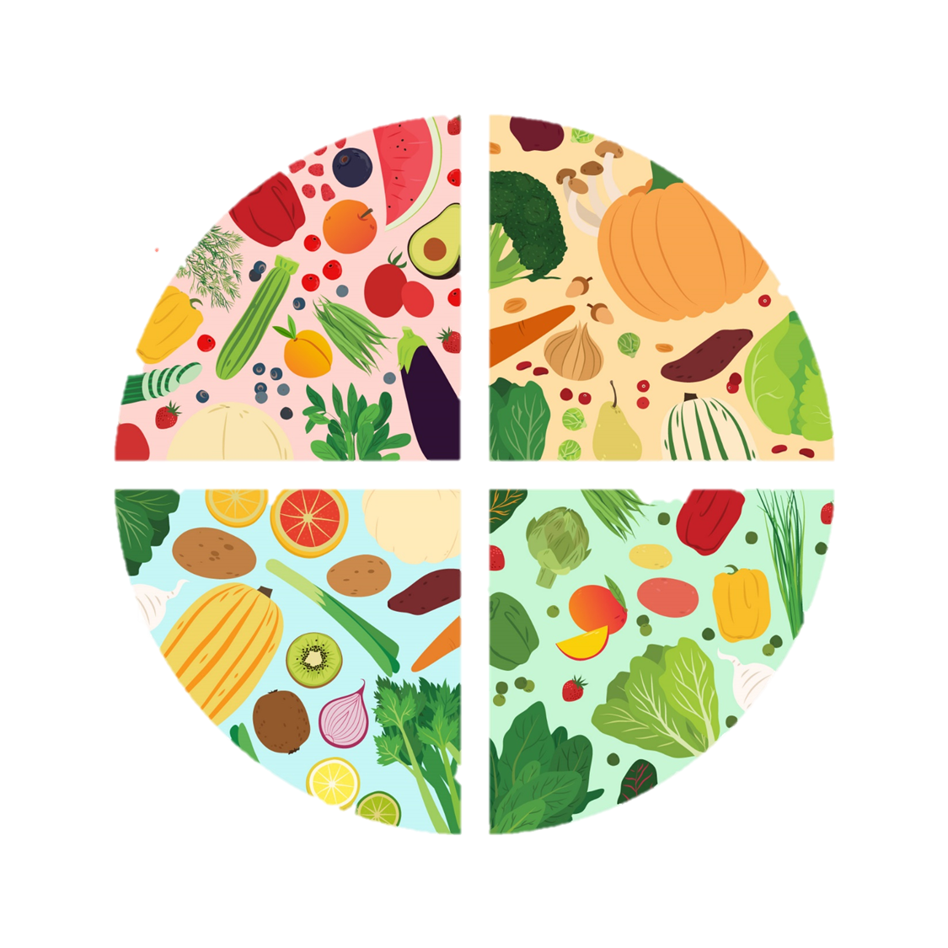
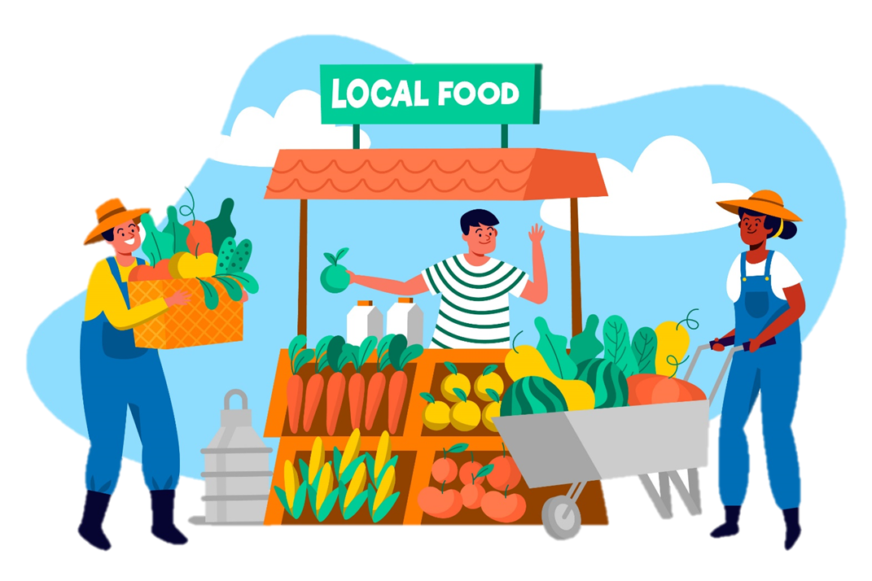
Reduce Carbon from Food
Eat Seasonal
Eat Seasonal
Eat Local

Slide 25
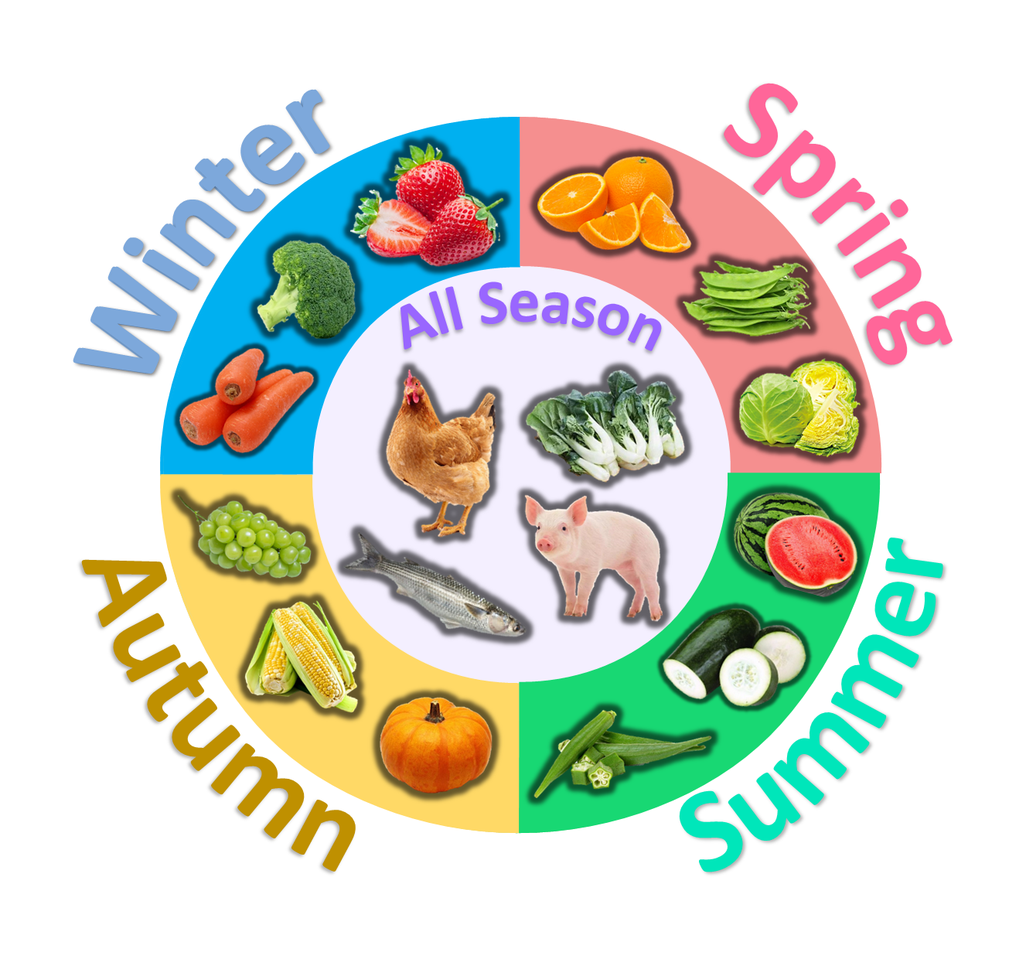
Local & Seasonal Food
Eat Seasonal
Benefit
Fresher Food
Reduce Carbon Footprint
Notes:
Local & Seasonal Food
Spring：Orange、Snow pea、Cabbage
Summer：Watermelon、Winter gourd、Okra
Autumn：Grape、Corn、Pumpkin
Winter：Strawberry、Broccoli、Carrot
All Season：Chicken、Pork、Chinese cabbage、Flathead mullet
Benefit of eating local and seasonal food
Fresher food
Reducing the risks of long-term storage damage and preservatives:
2. Reduce carbon footprint
Locally sourced ingredients can reduce the risks associated with freezing storage and excessive agriculture. If the locally sourced food is produced
locally, it can further reduce the distance of international long-distance transportation. Because the distance from the origin of the food to the table is
closer, the resulting greenhouse gas emissions will also decrease, reducing carbon footprint.
Reference：
「時令農作物收成表」, (低碳生活館) “Harvest Table of Seasonal food” <https://www.lowcarbonliving.hk/chi/SeasonalCropsharvesting.aspx>

Slide 26
Suggested Activities: Kindergarden

Slide 27

Suggested Activities - Kindergarden
Promote awareness of low-carbon diet among students through thematic teaching/activities:
Low-Carbon Diet Story:
Teachers can help children develop awareness and interest of low-carbon diet through pre-designed storyline.
2. Seasonal Food Guessing Game
teachers can invite children to match seasonal foods through the game which will help children develop an understanding of seasons and seasonal foods.
3. Low-Carbon Refreshments
Schools can prepare local and seasonal fruits as refreshments for children in which help foster children's interest in low-carbon diet and encourage them to practice it in their daily lives.

Slide 28

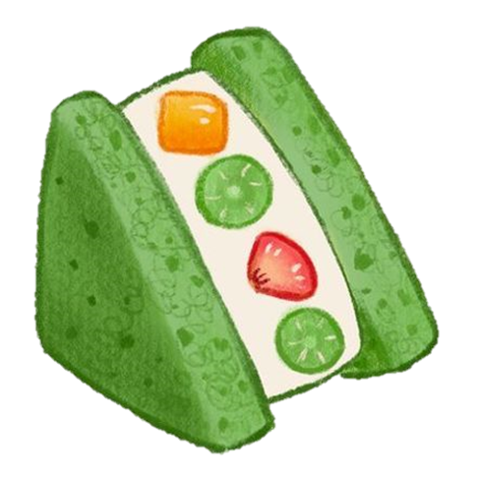

Suggested Activities - Kindergarden
Extended activity can cultivate a habit of low-carbon diet through daily school life for young children:
Family Trip - Local Fruit Picking Day:
Pick seasonal fruit or vegetable by visiting local farm.
Document the process of the activity through worksheet.
Creative Family Cooking Workshop:
Use seasonal ingredients to create snacks (e.g., sandwiches, rice balls, salads, crepes, etc.).
Through hands-on picking and preparing food, deepen children's understanding of unpackaged food and the importance of consuming local and seasonal ingredients.
Help children develop an interest in low-carbon diet and practice it in their daily lives.

Slide 29
Suggested Activities: Primary

Slide 30



活動建議 – 小學
Promote awareness of low-carbon diet among students through teaching activities:
Low Carbon Diet Lesson
Understand concepts of low carbon diet during lessons; Explore low carbon diet.
Low Carbon Diet Quiz
Enhance the concepts of low carbon by conduct a scoring quiz.
Design Your Own Shopping Bag
Design students’ own shopping bag; Develop the habits of carrying own shopping bag.
Dish Designing
Introduce students different mix and match of seasonal food and promote low carbon diet in school; Explore the methods of low carbon diet in daily life.

Slide 31
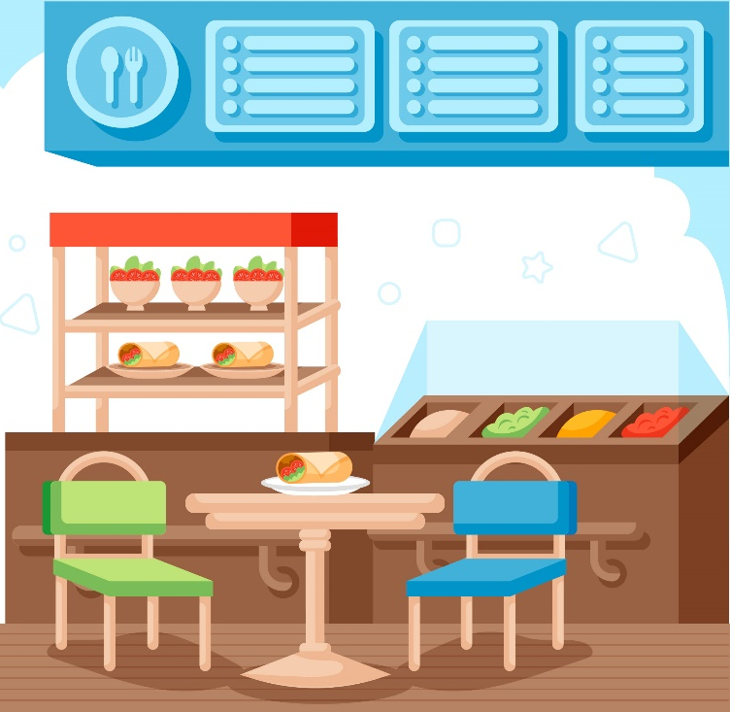
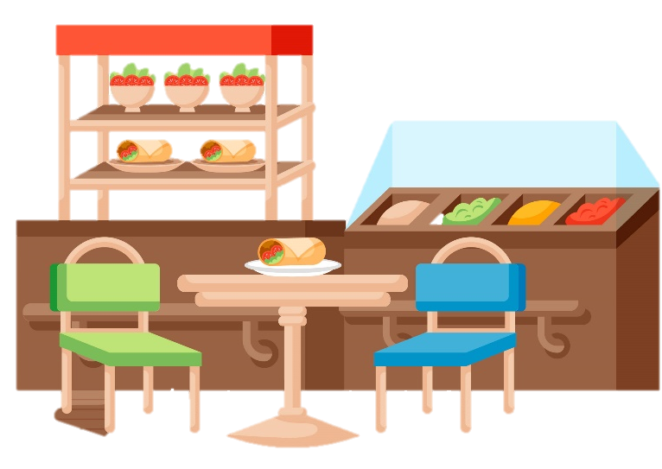


活動建議 – 小學
Extended activity can cultivate a habit of low-carbon diet through daily school life for promoting low carbon.
Naked Tuck Shop Day
Suspend package snacks, canned/bottled drinks and disposal utensils.
Provide locally made and/or seasonal food.
Low Carbon Diet Competition
Organize a low-carbon eating competition through dining activities at school with a scoring system, aiming at low carbon
Award awards/ prizes outstanding class for accomplishment.
Develop an interest in low-carbon diet

Slide 32
Suggested Activities: Secondary

Slide 33
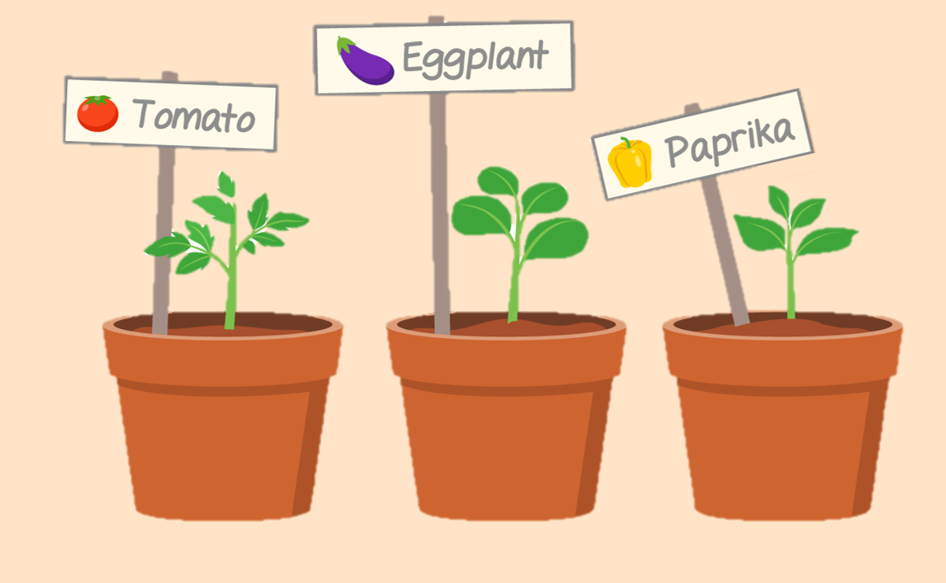
Activity Suggestion- Secondary
Low Carbon PLS
Promote awareness of low-carbon diet among students through thematic teaching/activities:
1. Lesson of Low-carbon Diet
Explore and understand the impact of food ingredients on carbon emissions in Hong Kong.
Introduce and understand the goals of the "Hong Kong Climate Action Plan 2050".
2. Local Seasonal Food (Quiz Game)
Enhance the knowledge and impact of Local Seasonal food on Carbon emission.
3. Campus Planting of Low-Carbon Ingredients
Cultivate an understanding the benefits of carbon reduction benefits through growing seasonal ingredients.
Explore the feasibility of campus planting to promote low-carbon diet.
4. Planting Sharing Session
Allow students to discuss the possibilities of growing local and seasonal ingredients for self usage and the benefit of reducing carbon emission.

Slide 34

Activity Suggestion- Secondary
Extended activity is to familiarize students with the concept of low-carbon diet and integrate it into campus and daily life to promote carbon reduction:
Creating Low-Carbon Recipes:
Students will create a low-carbon recipe to practice sustainable cooking and
increase their awareness of the carbon footprint through daily food choices.
Low-Carbon Culinary Competition:
Students will be encouraged to incorporate more local and seasonal ingredients into their daily meals and adopt a low-carbon diet through competition.
The aim is to cultivate a habit of low-carbon healthy diet and remind students of their responsibility to protect the planet.
Student will reflect the impact of food ingredients on carbon emissions through this activity experience and share it with others.

Slide 35
Reference
“Global Gridded Model of Carbon Footprints (GGMCF)” , (Dan Moran) - https://www.citycarbonfootprints.info/
「什麼是碳排放？和空污有什麼不同？為什麼您我需要減少碳排？」，（綠色和平） - https://www.greenpeace.org/taiwan/update/29407/什麼是碳排放？和空污有什麼不同？為什麼您我需/#:~:text=碳排放雖不會,卻影響氣候與環境&text=當平均氣溫和海洋,的生命與財產損失。
「政府公布《香港氣候行動藍圖2050》 」 ，（世界自然基金會香港分會） - https://ecobiz.wwf.org.hk/zh/hkcap2050
「碳中和、淨零排放是什麼？香港如何達成碳中和目標？ 」 ，（綠色和平） - https://www.greenpeace.org/hongkong/issues/climate/update/38072/碳中和、淨零排放是什麼？香港如何達成碳中和/
“A comprehensive review on carbon footprint of regular diet and ways to improving lowered emissions”, (H. Nabipour Afrouzi , J. Ahmed , B. Mobin Siddique , N. Khairuddin , Ateeb Hassan) -https://www.sciencedirect.com/science/article/pii/S2590123023001810
「減少包裝及包裝管理實用指引」 ，（環境保護署）- https://www.wastereduction.gov.hk/sites/default/files/resources_centre/Practical_Guides_on_Packaging_Reduction_And_Management-Supermarkets_and_Grocery_Stores_Sector_CHI.pdf
“Evaluation of life cycle inventory data for recycling systems”, (Brogaard, Line Kai-Sørensen; Damgaard, Anders; Jensen, Morten Bang; Barlaz, Morton ; Christensen, Thomas Højlund) - https://backend.orbit.dtu.dk/ws/portalfiles/portal/119496498/2014_Brogaard_et_Evaluation_of_life_cycle_inventory_data_for_recycling_systems_Postprint.pdf
“Analyzing the packaging strategy of packaging-free supermarkets”, (Christina Scharpenberg a, Meike Schmehl b, Milena Glimbovski c, Jutta Geldermann) - https://www.sciencedirect.com/science/article/abs/pii/S0959652621002687

Slide 36
Reference
「港九新界有齊！2023香港環保裸買店指南」，（綠色和平）- https://www.greenpeace.org/hongkong/issues/plastics/update/32953/港九新界有齊
“Is online shopping packaging waste a threat to the environment?”, (Yeonsu Kim, Jisoo Kang, Hyunbae Chun) - https://www.sciencedirect.com/science/article/abs/pii/S0165176522000684
「遠離網購更環保？ 過度包裝、碳足印、環保政策逐一拆解」 ，（綠色和平） - https://www.greenpeace.org/hongkong/issues/health/update/28669/遠離網購更環保？-過度包裝、碳足印、環保政策逐/
「念環境災害 網購前三思」，（梁恩賜）- https://www.foe.org.hk/tc/article/%E7%B6%A0%E8%89%B2%E8%B3%87%E8%A8%8A/%E6%96%87%E7%AB%A0/%E5%BF%B5%E7%92%B0%E5%A2%83%E7%81%BD%E5%AE%B3%20%E7%B6%B2%E8%B3%BC%E5%89%8D%E4%B8%89%E6%80%9D/1
「24,000人聯署有成！百佳2030年走塑承諾睇真啲」，（綠色和平）- https://www.greenpeace.org/hongkong/issues/plastics/update/26194/24000%E4%BA%BA%E8%81%AF%E7%BD%B2%E6%9C%89%E6%88%90%EF%BC%81%E7%99%BE%E4%BD%B32030%E5%B9%B4%E8%B5%B0%E5%A1%91%E6%89%BF%E8%AB%BE%E7%9D%87%E7%9C%9F%E5%95%B2/
「本地生產」, (低碳生活館) - https://www.lowcarbonliving.hk/chi/Local.aspx
“Food: greenhouse gas emissions across the supply chain” , (Our World in Data) - https://ourworldindata.org/grapher/food-emissions-supply-chain
“Hong Kong, China Food Products Imports by country in US$ Thousand 2021”, (World Integrated Trade Solution) - https://wits.worldbank.org/CountryProfile/en/Country/HKG/Year/LTST/TradeFlow/Import/Partner/by-country/Product/16-24_FoodProd

Slide 37
Reference
“Very little of global food is transported by air; this greatly reduces the climate benefits of eating local” , (Our World in Data) - https://ourworldindata.org/food-transport-by-mode
“Carbon Savings of Purchasing Local Seafood - Methodology and Result”, (Ocean Park)-
“8 Reasons To Love The Farm-To-Table Movement PLUS The Complete HK Farm-To-Table Dining List” , (Green Queen) - https://www.greenqueen.com.hk/the-complete-farm-to-table-hong-kong-restaurants-list/
“Influence of climate change on protected cultivation: Impacts and sustainable adaptation strategies - A review” , (Nazim Gruda , Mehdi Bisbis , Josef Tanny ) - https://www.sciencedirect.com/science/article/abs/pii/S0959652619309102
“Greenhouse gas emissions from vegetables production in China”, (Fen Zhang a, Fabo Liu a, Xiao Ma a b, Guangzheng Guo , Bin Liu , Taihong Cheng , Tao Liang , Weilin Tao , Xinping Chen , Xiaozhong Wang) - https:// www.sciencedirect.com/science/article/abs/pii/S0959652621026615
「時令農作物收成表」, (低碳生活館)- https://www.lowcarbonliving.hk/chi/SeasonalCropsharvesting.aspx
「時令新鮮」 , (低碳生活館)- https://www.lowcarbonliving.hk/chi/Seasonal.aspx

