Slide 1


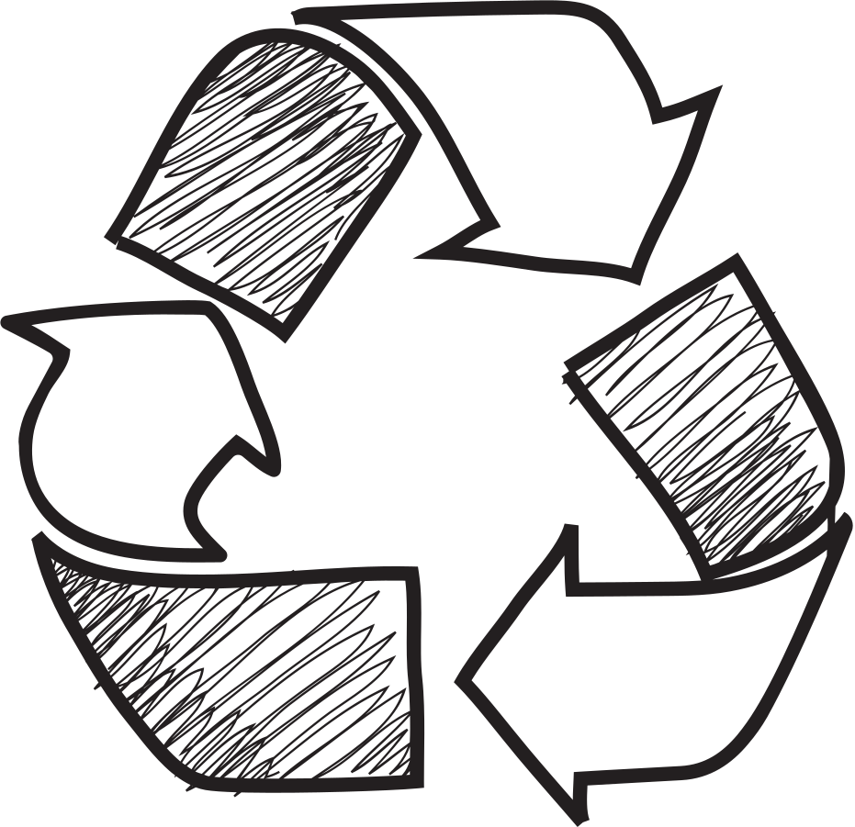


SGREEN

Slide 2
Content
Current recycling trend in Hong Kong ---------------------P.4-7
Importance of recycling --------------------------------------P.8
3-colour Waste Separation Bins in Hong Kong -----------P.9
Types of plastics ---------------------------------------------------P.10
Plastics recycling tips----------------------------------P.11-12
Paper recycling tips------------------------------------P.13-14
Metals recycling tips-----------------------------------P.15-16
Other recyclables --------------------------------------------P.17
Recycling facilities & GREEN@COMMUNITY----P.18-19
Recycling procedures ---------------------------------------P.20-21
Municipal Solid Waste Charging Scheme ------------------P.22-26

Slide 3
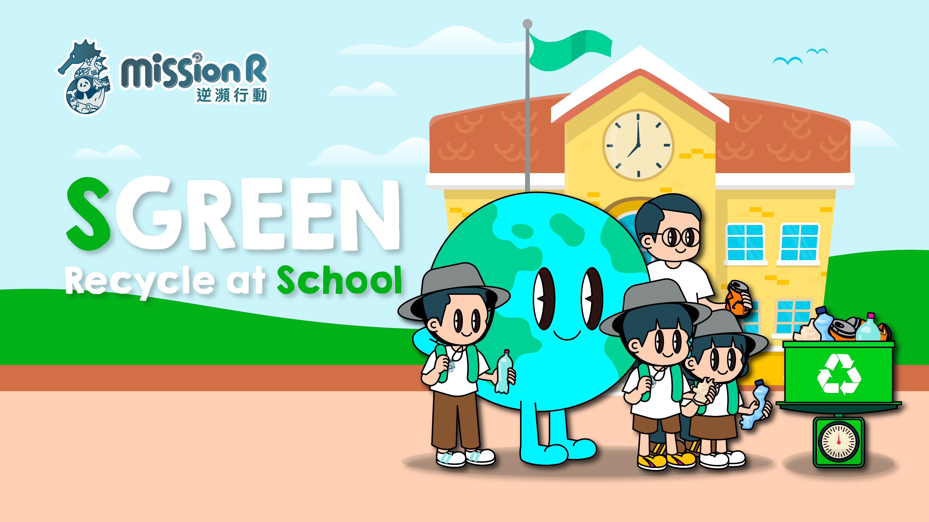

Slide 4




Statistics of Municipal Solid Waste (MSW) in 2021
Others
25%
Food Waste
30%
Glass & Metals
4%
Paper
20%
Plastics
21%
Total Amount of Waste：4.15 metric tons
Reference: Hong Kong 2021 Waste Statistics At a glance
https://www.wastereduction.gov.hk/sites/default/files/resources_centre/waste_statistics/msw2021_ataglance_eng.pdf

Slide 5
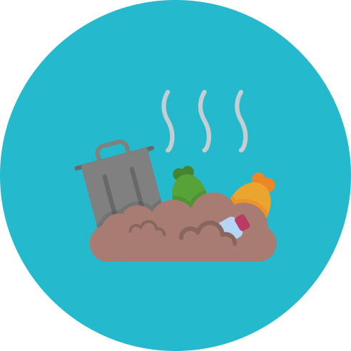


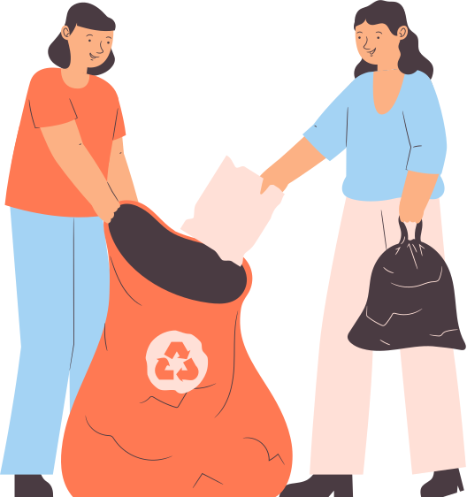
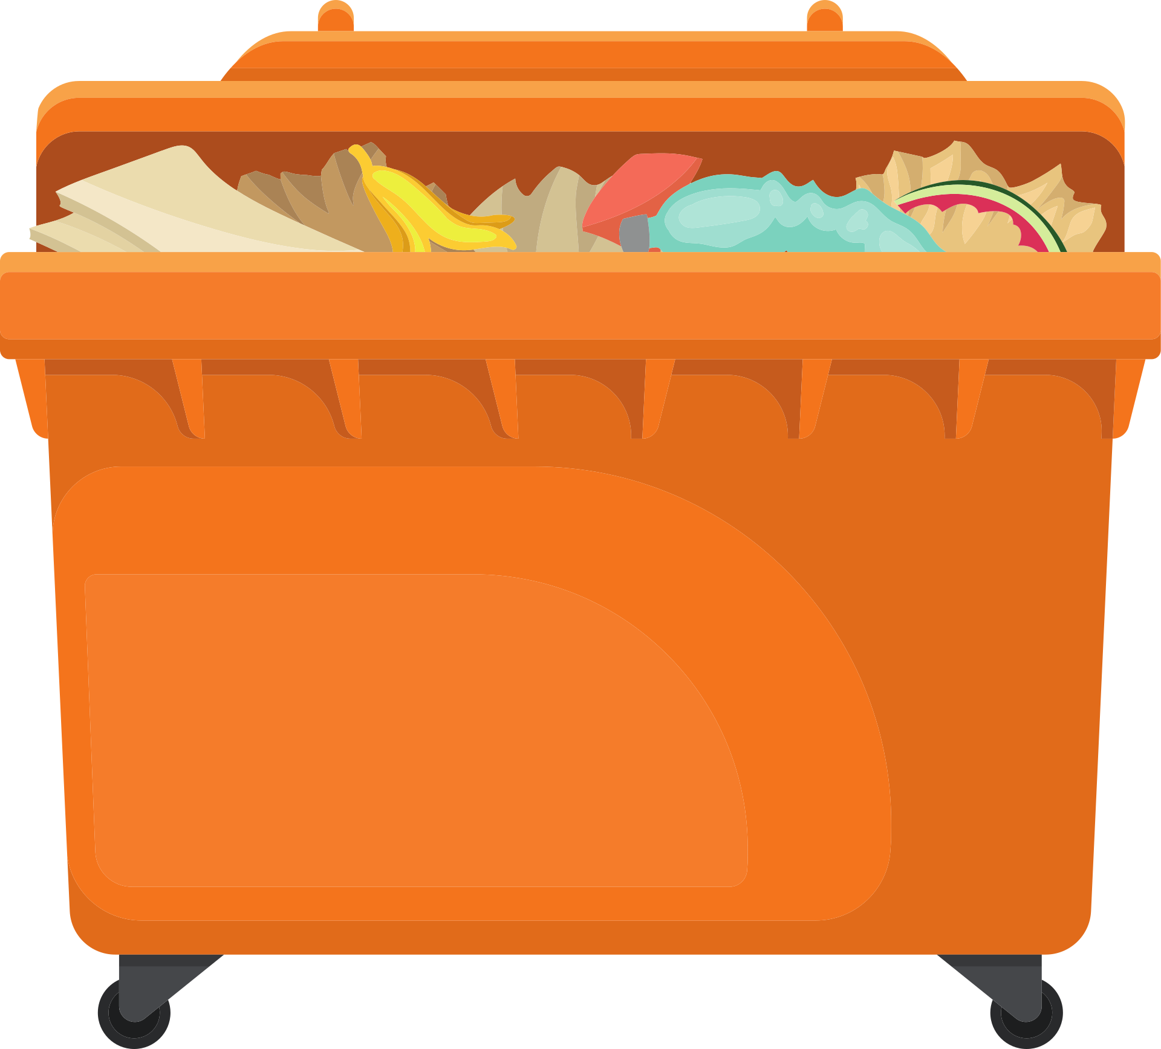
Disposal and recycling of MSW in Hong Kong 2021
Disposed of at landfills
69% of total amount of waste
Recycled
31% of total amount of waste
Reference：Hong Kong 2021 Waste Statistics At a glance
https://www.wastereduction.gov.hk/sites/default/files/resources_centre/waste_statistics/msw2021_ataglance_eng.pdf

Slide 6
Recyclables recovered from MSW in 2021
Others
4%
Food Waste 4%
Plastics
6%
Metals
53%
Paper
33%
Total disposal: 1.84 metric tons
Reference：Hong Kong 2021 Waste Statistics At a glance
https://www.wastereduction.gov.hk/sites/default/files/resources_centre/waste_statistics/msw2021_ataglance_eng.pdf

Slide 7
Weight of recyclables recovered from MSW from 2018-2021
Weight of all recyclables
Weight of plastics recycled
2,000
1841
1778
1,500
1639
1538
Weight
(1000 metric tons)
1,000
500
64
77
102
104
0
2018
2019
2020
2021
Reference: Monitoring of Solid Waste in Hong Kong Waste Statistics for 2021
https://www.wastereduction.gov.hk/sites/default/files/resources_centre/waste_statistics/msw2021_eng.pdf

Slide 8







Use of Raw Materials
Recovery of recyclables into new products
Energy Consumption
Why is recycling important?
Conserve the Environment
Carbon Dioxide
Air Pollution

Slide 9
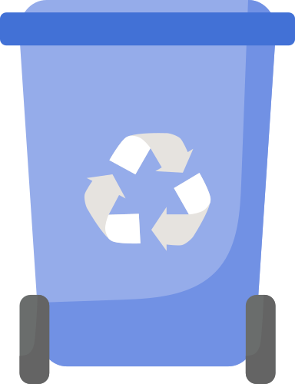
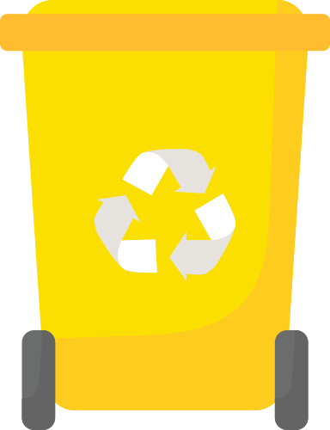
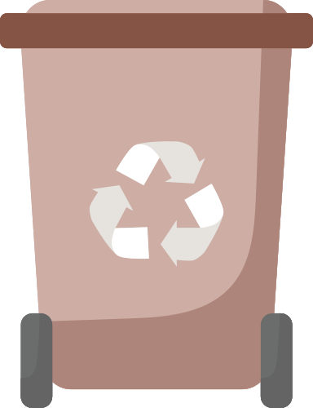
3-Colored Recycling bins in Hong Kong
Blue for Paper
Yellow for Metals
Brown for Plastics

Slide 10



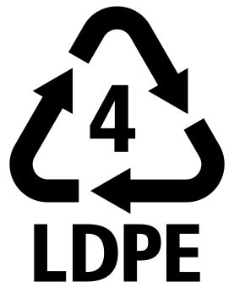







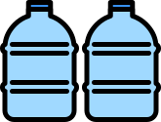


Types of Plastics
Beverage Plastics Bottles
Plastic egg cartons
Shampoo bottles
Body wash bottles
Cleaning products bottles
Packaging wrap
Water pipe
Bag
Rain coat
Plastic T-shirt bags
Bubble wrap
Transparent plastic bags
Soya milk bottles
Transparent / translucent plastics boxes
Bottle caps
Plastic straws
Disposable plastic tableware
Yakult bottles
Disposable plastic tableware
Japanese Take-Out Container
CD

Slide 11









Steps for Plastic bottles recycling
Remove bottle cap
Remove sleeves
Clean the bottle

Slide 12

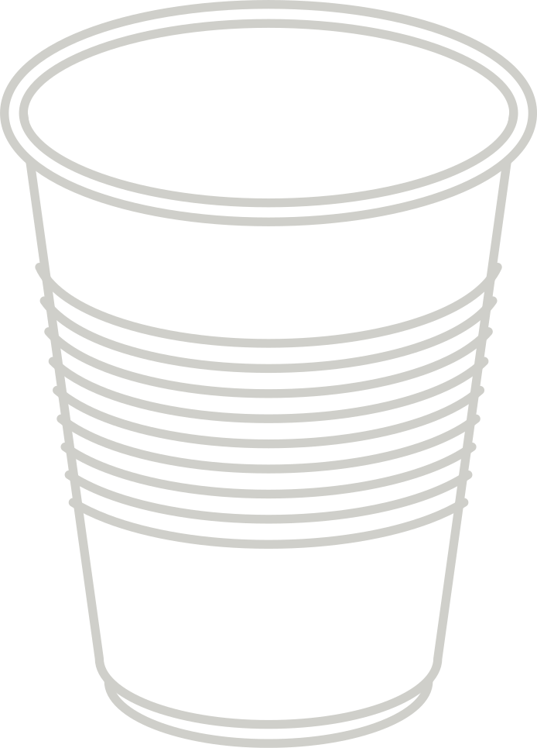
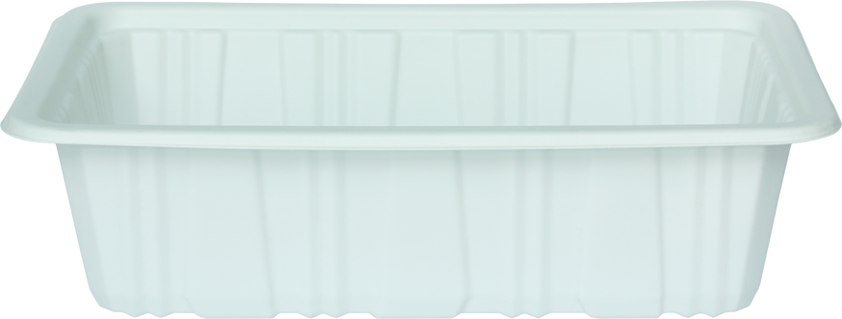




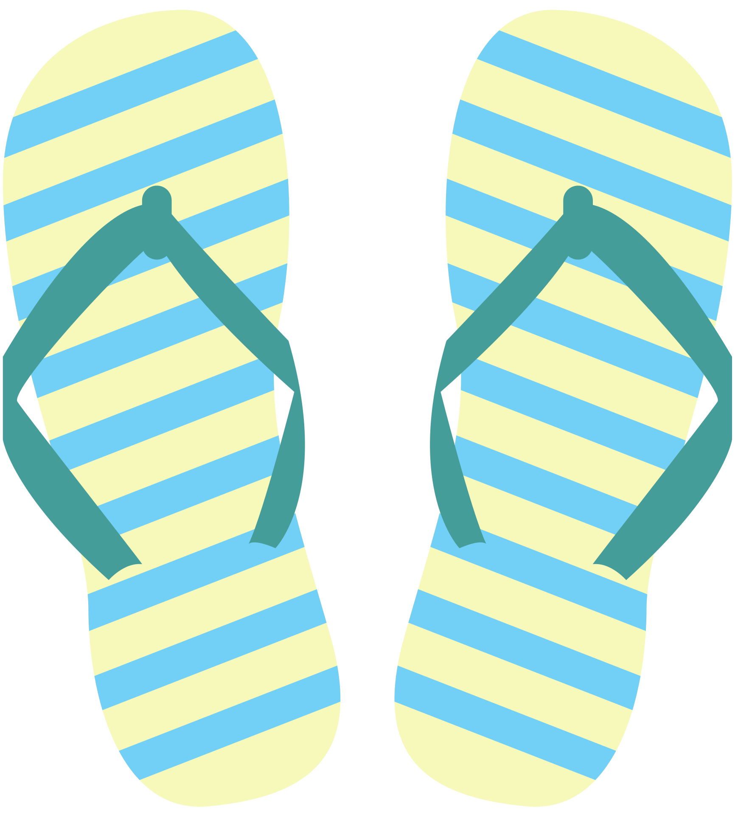

Recycling other kinds of plastics
Non-recyclable materials
Keep clean & dry, recycle according to the categories
Composite Materials

Slide 13
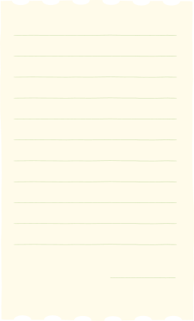









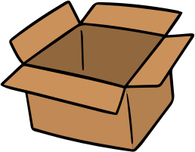






Recycling paper
Recyclables
Newspaper
Office paper
Cardboard
Books
Magazines
Beverage Cartons
Waste paper types that are not listed or of which recyclability is uncertain should not be put into recycling bins

Slide 14




Recycling paper
Remove plastic film on window envelope
Remove staples and rubber bands
Remove plastic films on cartons
Remove ramie and plastic handles on paper bags

Slide 15


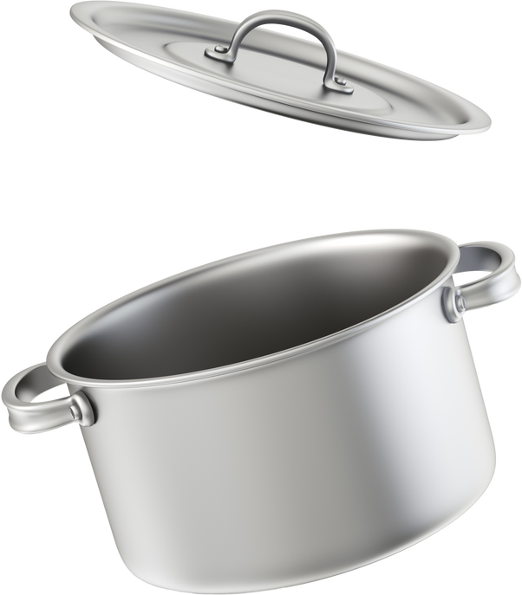




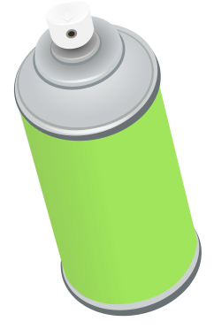

Recycling Metals
Recyclables
Aluminum Cans
Iron Cans
Cookware
Non-recyclables
Aerosol Cans
Chemical Containers

Slide 16



Flatten aluminum cans
Rinse metal containers
Waste sorting
Remove non-metal parts
Empty metal containers

Slide 17


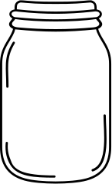


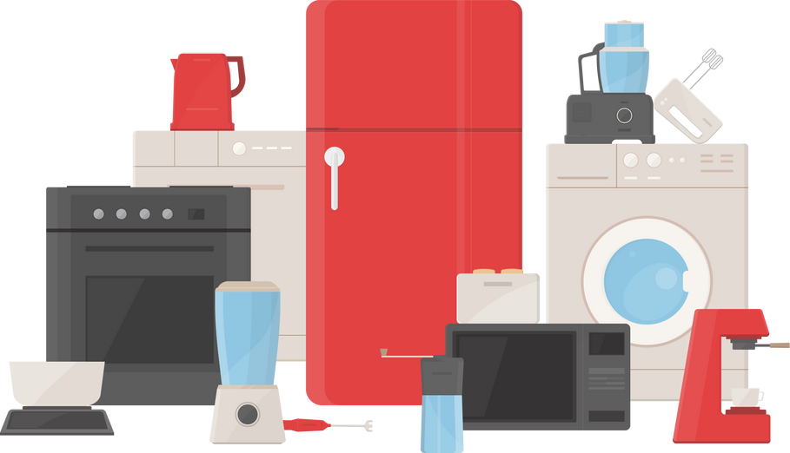
Other Recyclables
Rechargeable Batteries
Glass Bottles
Fluorescent Lamps and Tubes
Regulated Electrical Equipment &
Small Electrical Appliances

Slide 18
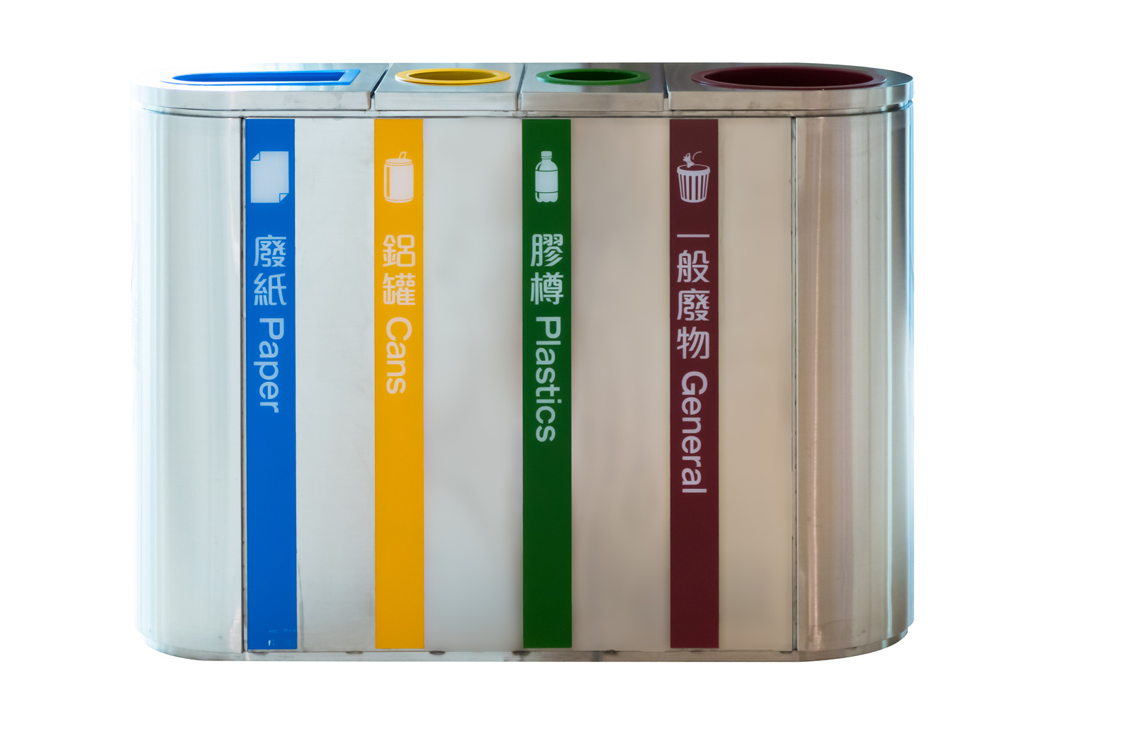
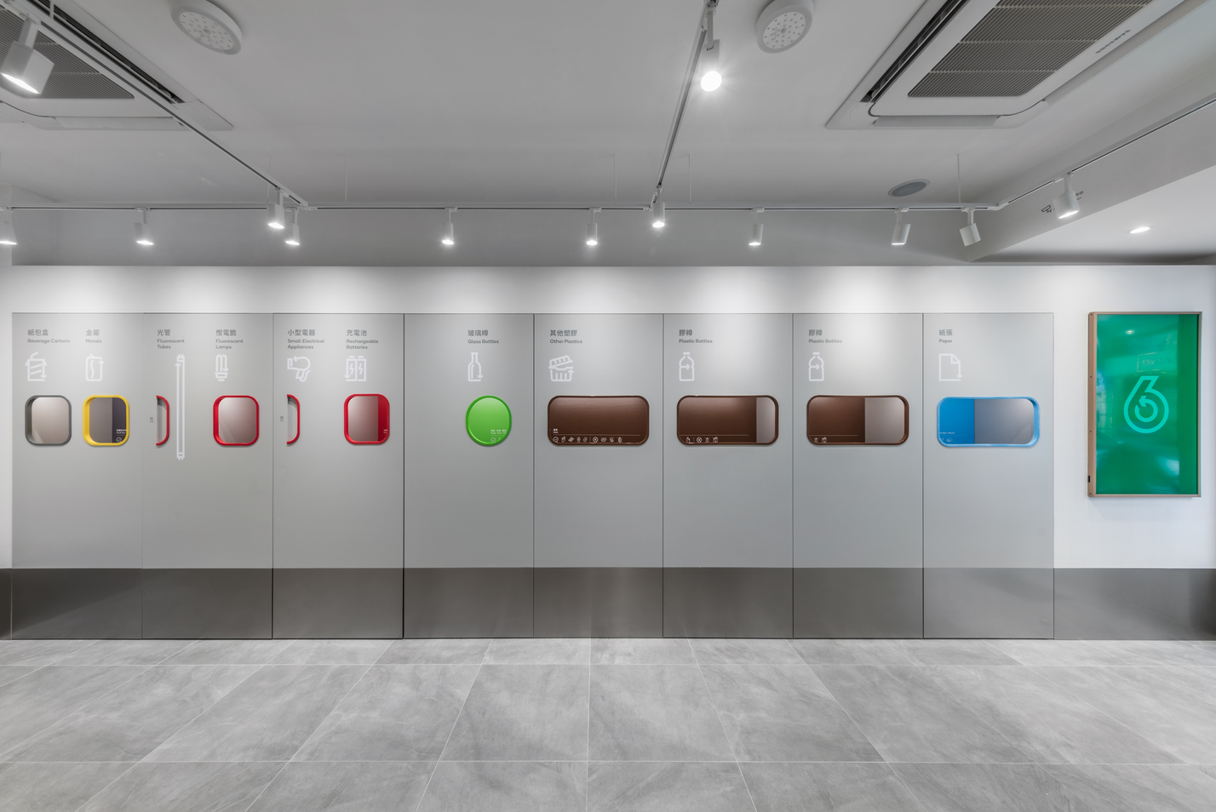
Recycling facilities
Operating 24-hour

Slide 19
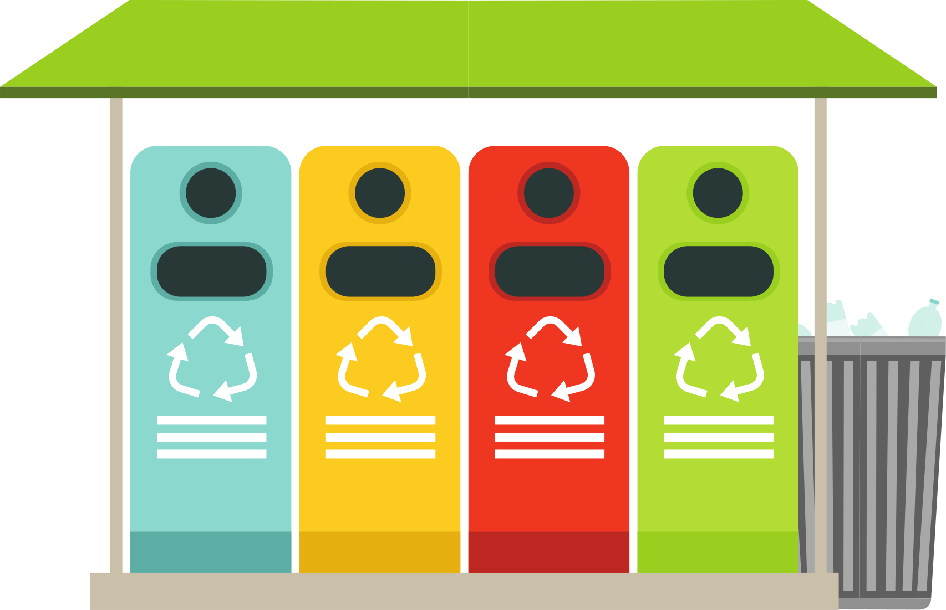
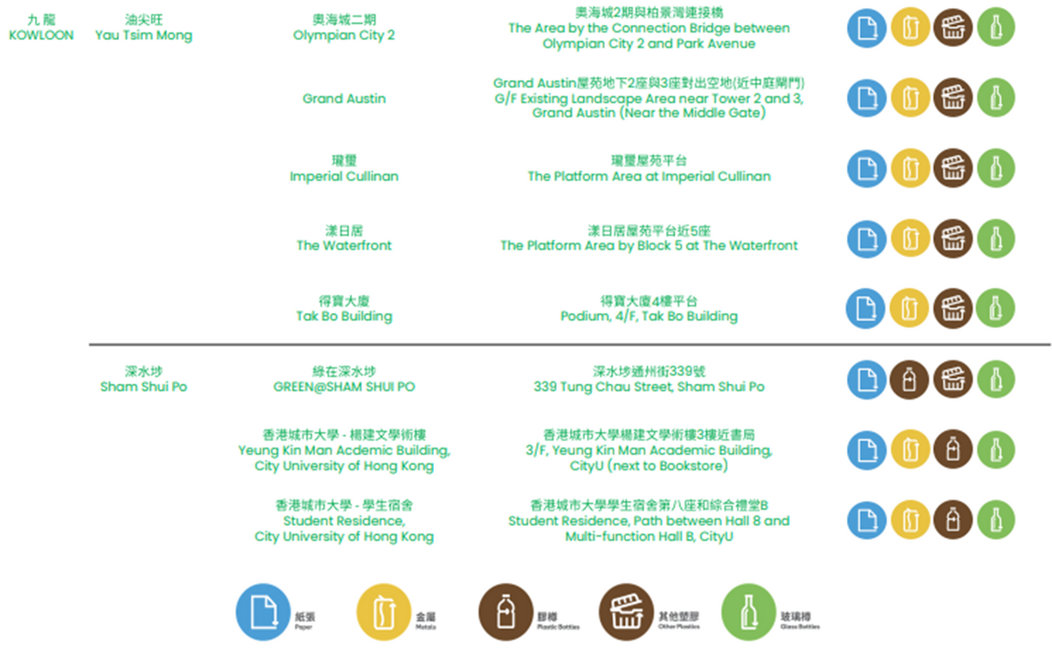
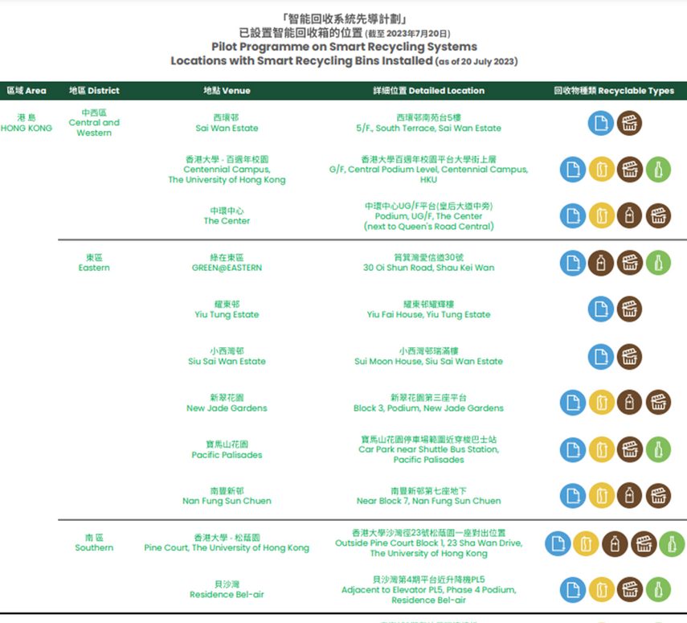
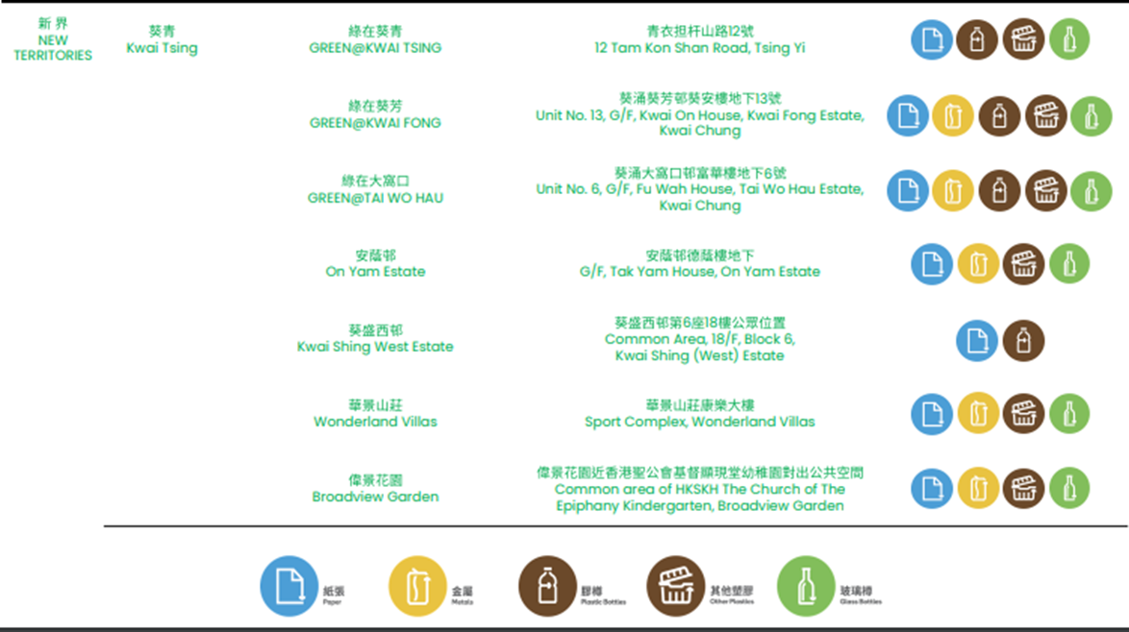
Locations of recycling facilities
Visit GREEN@COMMUNITY
Reference: GREEN@COMMUNITY
https://www.wastereduction.gov.hk/zh-hk/waste-reduction-programme/greencommunity#toc---3

Slide 20


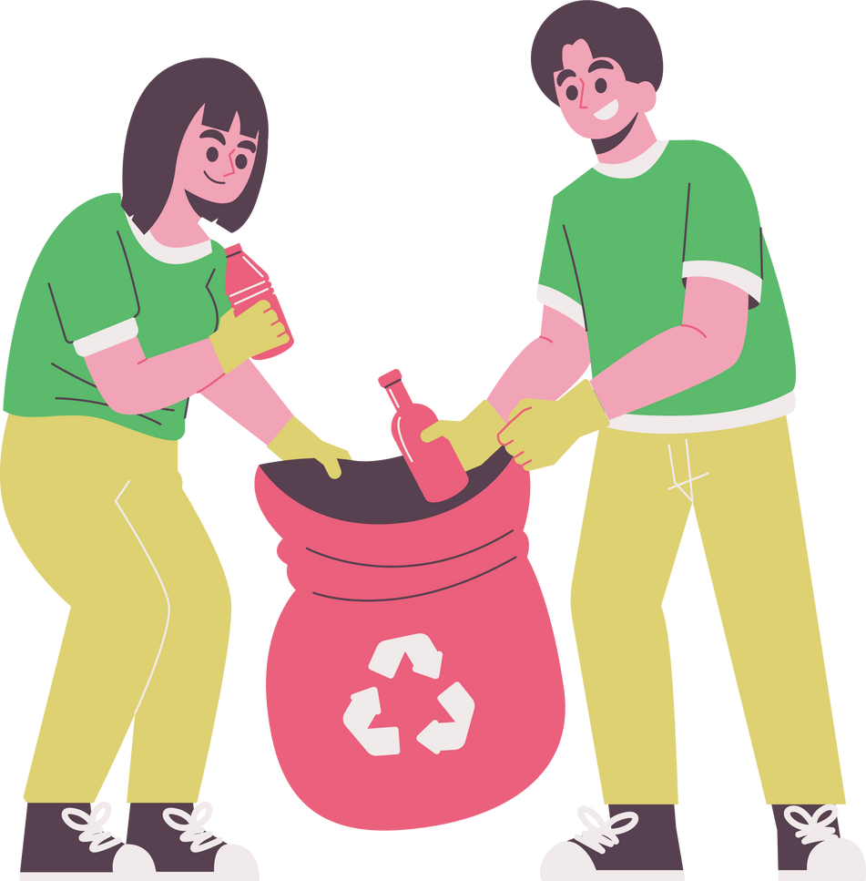
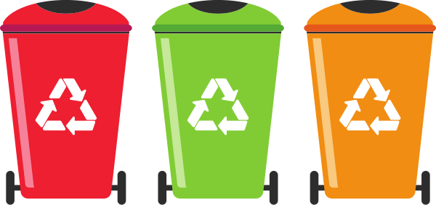


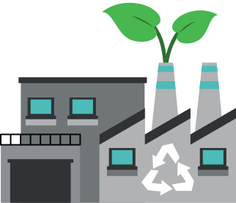

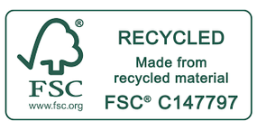

The Current Recycling Procedures in Hong Kong
Place them into the recycling bins or hand them to Green@Community
Collect and clean recyclables
Recreating a new product (Upcycling)
Turning used papers into toilet papers or paper towels
Adding glass cullet to bricks
Deliver recyclables to low stream recyclers
Sterilise, shred, sort and remove impurities recyclables to make raw material
Reference: Recycled Tissue - Mil Mill https://www.milmill.hk/recycled-tissue

Slide 21
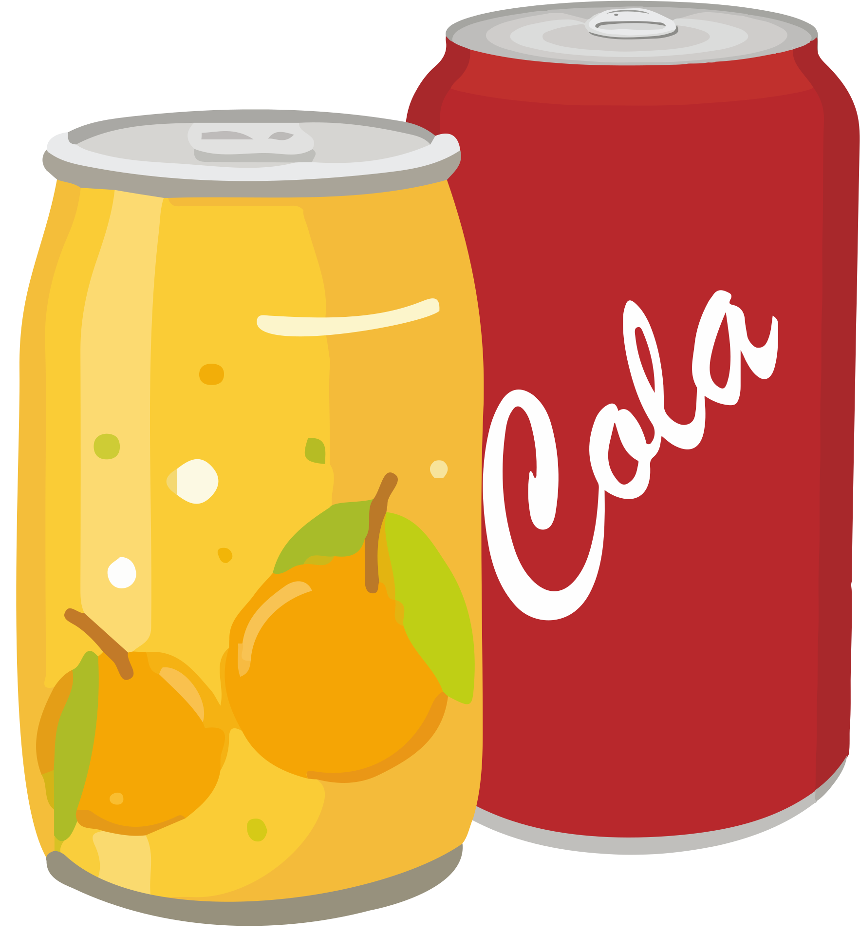


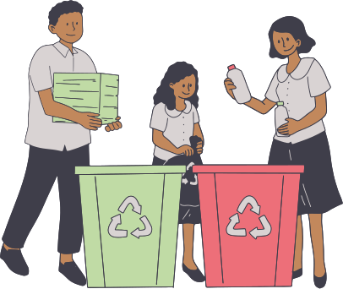
Case Study: Brazil
Remove impurities from aluminum cans collected by locals
Achieving pure and furnace-ready aluminum for manufacturing
The whole process takes around 60 days
+
Acheive recycling 100% of the aluminium
Reference: Environmental Protection Department – MSW Background
https://www.mswcharging.gov.hk/tc/about_us/background/
Recycling magazine – Aluminium recycling of Brazil
https://www.recycling-magazine.com/2023/08/29/aluminium-recycling-in-brasil/

Slide 22
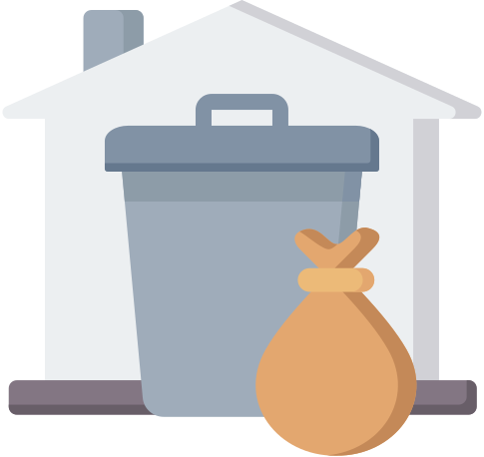

M﻿unicipal Solid Waste Charging Scheme - “Dump Less, Save More”
Definition of waste:
Domestic Waste:
Household waste and waste generated from daily activities in institutional premises (e.g., schools)
Commercial & Industrial Waste
Waste arising from shops, restaurants, hotels, offices, markets in private housing estates and all industrial activities
Background of Municipal Solid Waste Charging Scheme (MSW Charging):
Three existing landfills are expected to be filled up in the coming years
MSW charging is an effective policy tool to drive enterprises and the public to practice waste reduction and recycling
To facilitate the sustainable development of related industries and the creation of green job opportunities
To push for carbon emission reduction and combat climate change
Reference: Environmental Protection Department - MSW Background
https://www.mswcharging.gov.hk/tc/about_us/background/

Slide 23

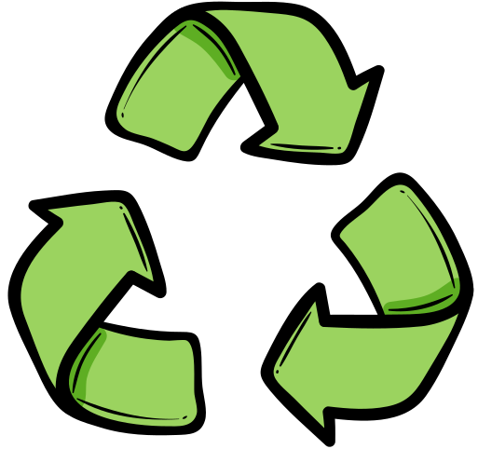
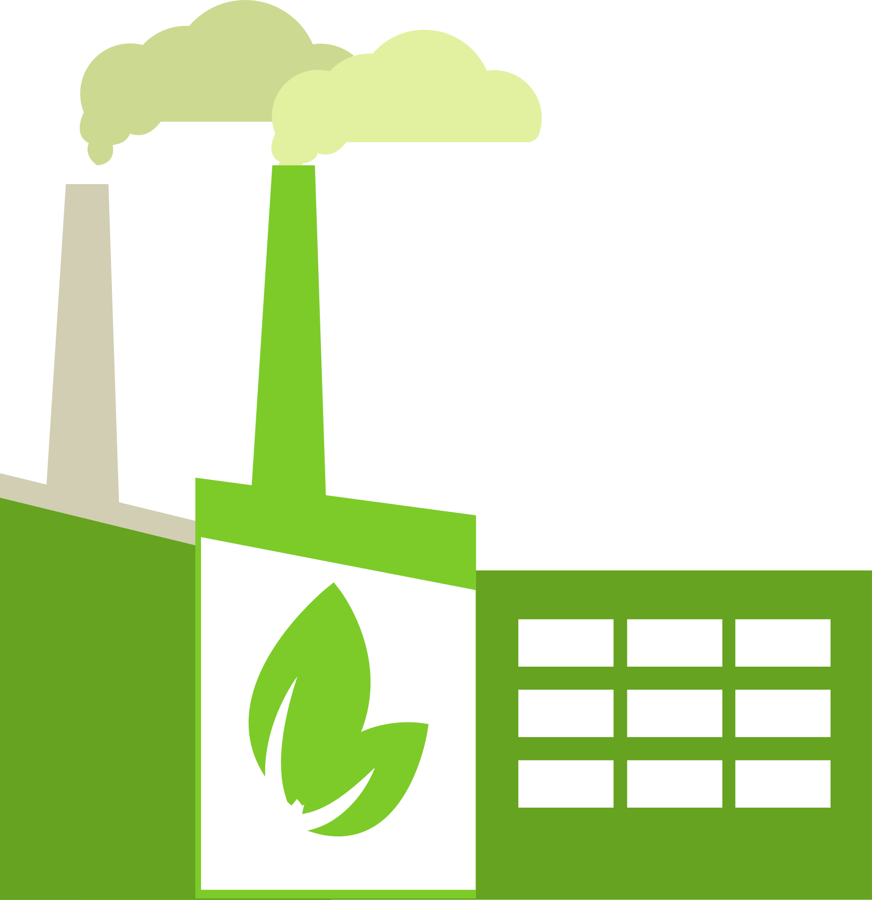

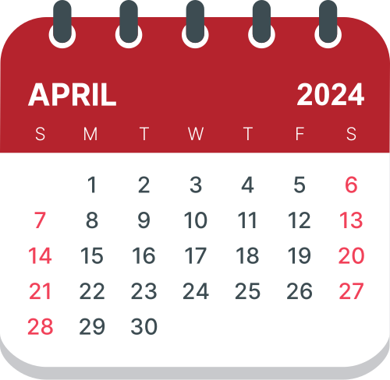

Municipal Solid Waste Charging Scheme - “Dump Less, Save More”
Three Goals
Enhance waste reduction and recycling
Help reduce carbon emissions
Create green job opportunities
Full implementation on 1 April 2024
Reference: Environmental Protection Department - MSW Background
https://www.mswcharging.gov.hk/tc/about_us/background/

Slide 24
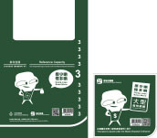
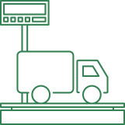
Municipal Solid Waste Charging Scheme - “Dump Less, Save More”
Charging Modes: in line with the "polluter-pays" principle
Charging by designated bags/ designated labels
Charging by weight through "gate-fee"
Reference: Environmental Protection Department - MSW Background
https://www.mswcharging.gov.hk/tc/database/resource-centre-qna/#q1

Slide 25
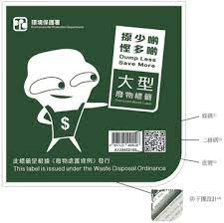
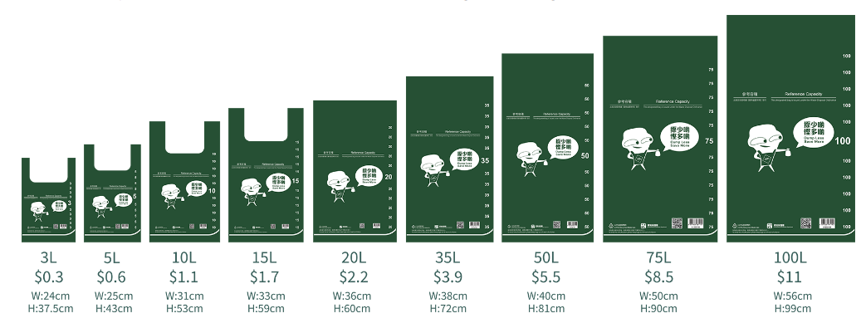
M﻿unicipal Solid Waste Charging Scheme - “Dump Less, Save More”
Charging by designated bags/ designated labels
Applicable to most residential buildings, commercial and industrial buildings, village houses, street-level shops and institutional premises, etc.
Each designated bag and designated label comes with anti-counterfeit features; HKD$0.11 per litre
Each designated bag would be charged for HKD$0.11 despite the size and weight
Reference: Environmental Protection Department - MSW Background
https://www.mswcharging.gov.hk/tc/database/resource-centre-qna/#q1

Slide 26
M﻿unicipal Solid Waste Charging Scheme - “Dump Less, Save More”
Charging by weight through "gate-fee"
Applicable to oversized waste or waste which is irregular in shape from commercial and industrial premises
When such waste is disposed of at the refuse transfer stations and landfills, a “gate-fee” will be charged based on its weight
Apply for being the "Type B Account" holders
"Type B Account" holders could engage vehicles registered under "Type A Account" to dispose of waste at waste disposal facilities
Reference: Environmental Protection Department – MSW Background
https://www.mswcharging.gov.hk/tc/database/resource-centre-qna/#q1

