Slide 1
Hack your Reality hackathon
Registration & team formation
guide

Slide 2


Step 1: click on ‘register now’

Slide 3


Step 2: click on ‘view team’ to set up your team

Slide 4
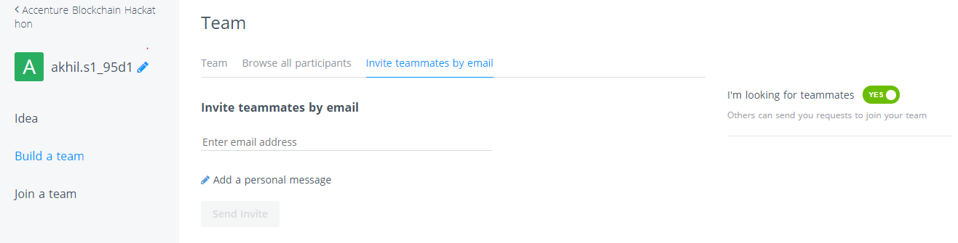
Step 3: change your team name; toggle to ‘yes’ to look for teammates; invite teammates by e-mail

Slide 5
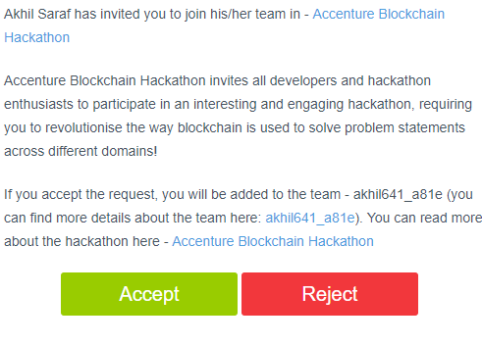
Step 4: the invited person receives this email

Slide 6
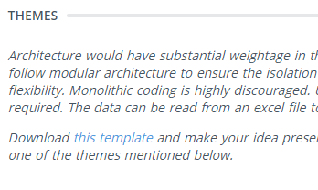
Step 5: click on ‘this template’ in the ‘themes’ section to download the PPT template for your idea submission

Slide 7


Step 6: click on ‘submit your idea’ on the main page to provide your idea details

Slide 8
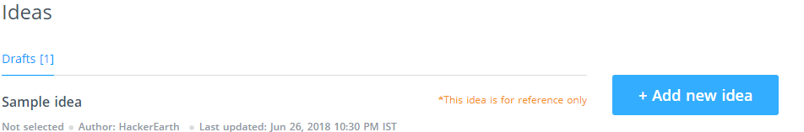
Step 7: click on ‘sample idea’ to see what a good idea needs; then click on ‘add new idea’

Slide 9
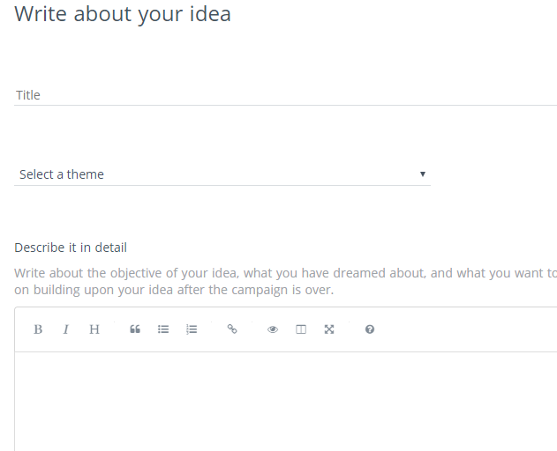
Step 8: put in the idea title, select your theme, and put in the idea synopsis

Slide 10
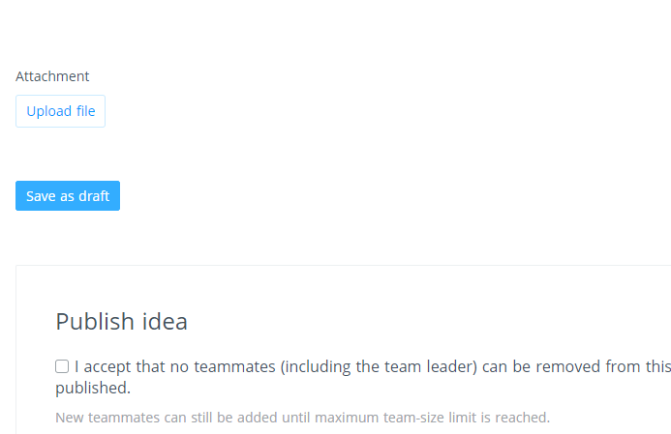
Step 9: use ‘upload file’ to submit your ppt; save your idea as a draft; click on ‘publish idea’ for final submission

