Slide 1
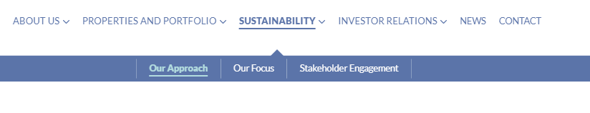
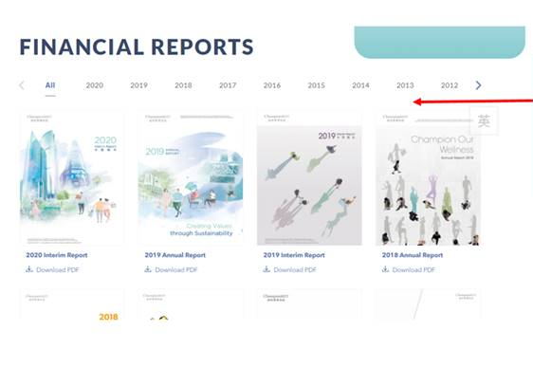
ESG Report sub-section under Sustainability
Sustainability Reports
Please add one sub-section – Sustainability Reports under Sustainability as we will upload our standalone Sustainability Report in March this year;
Please enable the “hide/show” function
Token quotation by Digisalad
Option 1: same as "Financial Report" - 1 day

Slide 2
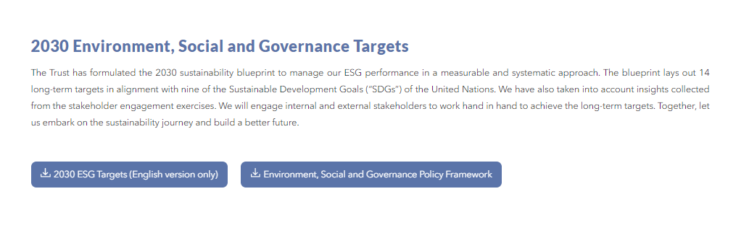
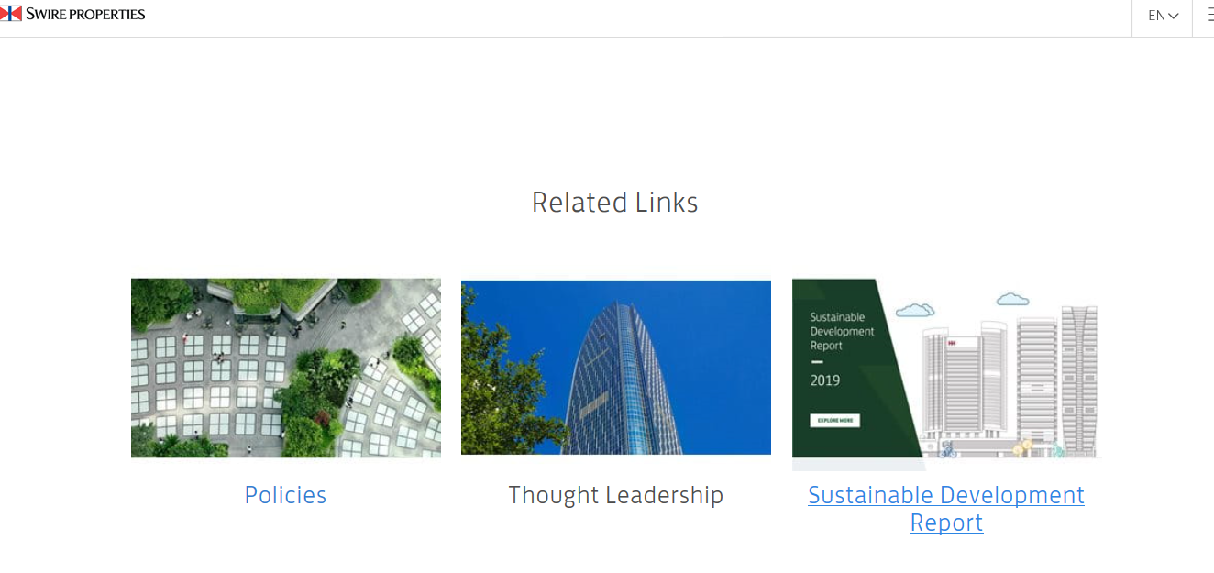
Additional button for PDF / hyperlink
Token quotation by Digisalad: 3 days
Please add one more button for pdf / hyperlink;
Please enable the “hide/show” function
Please replace the three buttons with pictures, similar to below

