Slide 1
Real Insight – Q1 FY’20
July 2019

Slide 2
Executive Summary – Q1 FY’20
New supply continued its downtrend, declining 47% over last year and 32% over the previous quarter. Except Gurugram, new launches reduced across cities during the June quarter
Overall sales in 9 cities also decreased by 11% over last year. Except Gurugram, Hyderabad, Kolkata and Pune, all other cities recorded decline in sales as compared to Q1FY’19. Gurugram witnessed the highest increase of 32% YoY in sales
Over 18% decline was recorded in the sales of under construction properties against the previous quarter
Unsold inventory of top 9 cities further reduced by 12% year-on-year and overall inventory overhang reduced marginally to 30 months. Hyderabad has the lowest inventory overhang of 15 months whereas Noida has the highest of 41 months
Ahmedabad and Chennai have the highest share of ready-to-move-in units in the overall unsold inventory stock
Hyderabad continued its price rally during the quarter, with 17% appreciation over the previous year. Except NCR & Chennai whereas prices saw some correction, all other cities witnessed marginal price appreciation in the past one year
Affordable housing continued to dominate the supply and launches across cities. Ahmedabad, Pune and Kolkata have more than 70% of the unsold inventory in the <Rs.50-Lakhs segment
In June quarter, over 120,500 units have been offered for possession to customers and nearly 5 Lakhs more units are likely to be delivered till Mar’20

Slide 3
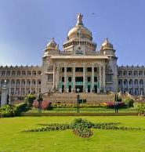
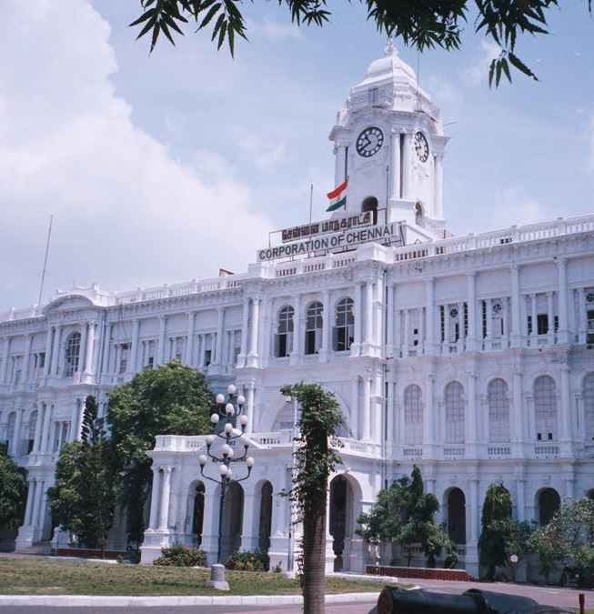
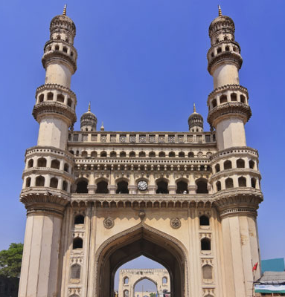


Residential Landscape: Top-9 cities as of Q1 FY’20 over last year
AHMEDABAD
Y-o-Y (%)
Launches | -89%
Sales | -36%
BSP | -1% (2,857)
Inventory Overhang | -21% (38)
BENGALURU
Y-o-Y (%)
Launches | -41%
Sales | -17%
BSP | 3% (5,157)
Inventory Overhang | -13% (24)
CHENNAI
Y-o-Y (%)
Launches | -32%
Sales | -2%
BSP | 0% (5,174)
Inventory Overhang | -12% (24)
GURUGRAM
Y-o-Y (%)
Launches | 130%
Sales | 32%
BSP | -3% (4,950)
Inventory Overhang | -10% (28)
HYDERABAD
Y-o-Y (%)
Launches | -56%
Sales | 10%
BSP | 17% (5,131)
Inventory Overhang | -42% (15)
KOLKATA
Y-o-Y (%)
Launches | -30%
Sales | 10%
BSP | 1% (3,936)
Inventory Overhang | -11% (36)
MMR
Y-o-Y (%)
Launches | -62%
Sales | -14%
BSP | 3% (9,396)
Inventory Overhang | -28% (32)
NOIDA
Y-o-Y (%)
Launches | -52%
Sales | -56%
BSP | 0% (3,899)
Inventory Overhang | 2% (41)
PUNE
Y-o-Y (%)
Launches | -42%
Sales | 5%
BSP | 2% (4,821)
Inventory Overhang | -35% (25)
Notes:
1. Y-o-Y is comparison between the corresponding quarter of the previous year and the current quarter 2. BSP is represented in Rs./sq.ft. over super area
3. Inventory overhang is represented in months. 4. MMR is Mumbai Metropolitan Region which includes Navi Mumbai and Thane

Slide 4
Sales decline 17% whereas inventory overhang improves 3% over last quarter
Residential trends in top-9 cities* Q-o-Q
Launches
-3%
-17%
18%
-21%
- 32%
Sales
-3%
8%
2%
-2%
-17%
Price Trend
1%
1%
0%
1%
0%
Inventory Overhang
2%
17%
-9%
-11%
-3%
Q1 FY’19
Q2 FY’19
Q3 FY’19
Q4 FY’19
Q1 FY’20
/
Strong/Marginal Decline
Stable
Strong/Marginal Increase
Notes: * Top 9 Cities are MMR (Mumbai, Navi Mumbai & Thane), Pune, Noida (including Greater Noida & Yamuna Expressway), Gurugram (including Bhiwadi, Dharuhera & Sohna), Bengaluru, Chennai, Hyderabad, Kolkata and Ahmedabad.
Analysis includes apartments and villas across the regions.

Slide 5
1…………... Launches: The Fall Continues

Slide 6
Downturn continues in launches; 32% decline seen over previous quarter
# of units
47%
32%
Notes: * Top 9 Cities are MMR (Mumbai including Navi Mumbai & Thane), Pune, Noida (including Greater Noida & Yamuna Expressway), Gurugram (including Bhiwadi, Dharuhera & Sohna), Bengaluru, Chennai, Hyderabad, Kolkata and Ahmedabad.
Analysis includes apartments and villas across the regions.

Slide 7
Gurugram bucks the trend; Ahmedabad witnesses the biggest decline
# of units
Notes: * Noida includes Greater Noida and Yamuna Expressway.
** MMR – Mumbai Metropolitan Region (Mumbai includes Navi Mumbai and Thane)
^ Gurugram includes Bhiwadi, Dharuhera and Sohna.
Analysis includes apartments and villas across the regions.

Slide 8
Housing units within 60 sq. mts of carpet area accounts for 48% of new units launches in June quarter
% of units
Notes: * Top 9 Cities are MMR (Mumbai including Navi Mumbai & Thane), Pune, Noida (including Greater Noida & Yamuna Expressway), Gurugram (including Bhiwadi, Dharuhera & Sohna), Bengaluru, Chennai, Hyderabad, Kolkata and Ahmedabad.
Analysis includes apartments and villas across the regions.

Slide 9
Nearly 51% of new units launched priced within Rs. 50-Lakhs budget¹
% of units
Notes: 1. Budget is based on basic price and does not include additional costs as well as taxes, stamp duty and registration costs 2. Top 9 Cities are MMR (Mumbai including Navi Mumbai & Thane), Pune, Noida (including Greater Noida & Yamuna Expressway), Gurugram (including Bhiwadi, Dharuhera & Sohna), Bengaluru, Chennai, Hyderabad, Kolkata and Ahmedabad.
Analysis includes apartments and villas across the regions.

Slide 10
2……Consumer & Demand :
Sales Subdue

Slide 11
Sales decline 11% over last year & 17% over previous quarter
# of units
11%
Notes: * Top 9 Cities are MMR( Mumbai including Navi Mumbai & Thane), Pune, Noida (including Greater Noida & Yamuna Expressway), Gurugram (including Bhiwadi, Dharuhera & Sohna), Bengaluru, Chennai, Hyderabad, Kolkata and Ahmedabad.
Analysis includes apartments and villas across the regions.

Slide 12
Gurugram witnesses significant improvement in sales over last year, whereas, Noida shows major decline
# of units
Notes: * Noida includes Greater Noida and Yamuna Expressway.
** MMR – Mumbai Metropolitan Region (Mumbai includes Navi Mumbai and Thane)
^ Gurugram includes Bhiwadi, Dharuhera and Sohna.
Analysis includes apartments and villas across the regions.

Slide 13
Severe decline seen in sales of under-construction units over Q4FY’19
# of units
CAGR (12 qtrs)
- 7.2%
19%
Notes: * Top 9 Cities are MMR (Mumbai including Navi Mumbai & Thane), Pune, Noida (including Greater Noida & Yamuna Expressway), Gurugram (including Bhiwadi, Dharuhera & Sohna), Bengaluru, Chennai, Hyderabad, Kolkata and Ahmedabad.
Analysis includes apartments and villas across the regions.

Slide 14
Units priced within Rs.50-Lakhs budget¹ continue to contribute over 54% to sales
% of units
Notes: 1. Budget is based on basic price and does not include additional costs as well as taxes, stamp duty and registration costs 2. Top 9 Cities are MMR (Mumbai including Navi Mumbai & Thane), Pune, Noida (including Greater Noida & Yamuna Expressway), Gurugram (including Bhiwadi, Dharuhera & Sohna), Bengaluru, Chennai, Hyderabad, Kolkata and Ahmedabad.
Analysis includes apartments and villas across the regions.

Slide 15
Units with carpet area <60 sq mts contribute 50% to sales
% of units
Notes: * Top 9 Cities are MMR(Mumbai including Navi Mumbai & Thane), Pune, Noida (including Greater Noida & Yamuna Expressway), Gurugram (including Bhiwadi, Dharuhera & Sohna), Bengaluru, Chennai, Hyderabad, Kolkata and Ahmedabad.
Analysis includes apartments and villas across the regions.

Slide 16
Over 50% of units sold in Gurugram’s peripheral areas priced below Rs.25 Lakhs
% of units
Notes: 1. Budget is based on basic price and does not include additional costs as well as taxes, stamp duty and registration costs * Noida includes Greater Noida and Yamuna Expressway. ** MMR – Mumbai Metropolitan Region (Mumbai includes Navi Mumbai and Thane) ^ Gurugram includes Bhiwadi, Dharuhera and Sohna.
Analysis includes apartments and villas across the regions.

Slide 17
Nearly 500,000 units expected to be delivered by Mar’20
# of units
Expected Delivery
Note: Analysis includes apartments and villas across the regions.

Slide 18
3………Inventory: Overhang Reduces

Slide 19
Inventory overhang improves, reaches at less than 3 years of sales velocity
# of months
Notes: * Top 9 Cities are MMR( Mumbai including Navi Mumbai & Thane), Pune, Noida (including Greater Noida & Yamuna Expressway), Gurugram (including Bhiwadi, Dharuhera & Sohna), Bengaluru, Chennai, Hyderabad, Kolkata and Ahmedabad.
Analysis includes apartments and villas across the regions.

Slide 20
Unsold inventory lowest in last 3 years
# of units
12%
Notes: * Top 9 Cities are MMR (Mumbai including Navi Mumbai & Thane), Pune, Noida (including Greater Noida & Yamuna Expressway), Gurugram (including Bhiwadi, Dharuhera & Sohna), Bengaluru, Chennai, Hyderabad, Kolkata and Ahmedabad.
Analysis includes apartments and villas across the regions.

Slide 21
NCR holds the highest share of unsold inventory aged above 3 years
% of units
Notes: * Noida includes Greater Noida and Yamuna Expressway.
** MMR – Mumbai Metropolitan Region (Mumbai includes Navi Mumbai and Thane.)
^ Gurugram includes Bhiwadi, Dharuhera and Sohna.
Analysis includes apartments and villas across the regions.

Slide 22
Hyderabad has the best inventory profile (lowest age as well as lowest overhang)
Age of unsold
inventory (months)
Inventory overhang (months)
Notes: * Top 9 Cities are MMR (Mumbai including Navi Mumbai & Thane), Pune, Noida (including Greater Noida & Yamuna Expressway), Gurugram (including Bhiwadi, Dharuhera & Sohna), Bengaluru, Chennai, Hyderabad, Kolkata and Ahmedabad.
Analysis includes apartments and villas across the regions.
Size of the bubble indicates total inventory in units.

Slide 23
Half of unsold units is sized below <60 sq mts carpet area
% of units
Notes: * Top 9 Cities are Mumbai (including Navi Mumbai & Thane), Pune, Noida (including Greater Noida & Yamuna Expressway), Gurugram (including Bhiwadi, Dharuhera & Sohna), Bengaluru, Chennai, Hyderabad, Kolkata and Ahmedabad.
Analysis includes apartments and villas across the regions.

Slide 24
Ahmedabad, Pune and Kolkata have more than 70% of the unsold inventory in the <Rs.50-Lakhs segment
% of units
Notes: 1. Budget is based on basic price and does not include additional costs as well as taxes, stamp duty and registration costs * Noida includes Greater Noida and Yamuna Expressway. ** MMR – Mumbai Metropolitan Region (Mumbai includes Navi Mumbai and Thane) ^ Gurugram includes Bhiwadi, Dharuhera and Sohna.
Analysis includes apartments and villas across the regions.

Slide 25
Ahmedabad and Chennai have the highest share of completed units in unsold inventory
% of units
Notes: * Noida includes Greater Noida and Yamuna Expressway.
** MMR – Mumbai Metropolitan Region (Mumbai includes Navi Mumbai and Thane)
^ Gurugram includes Bhiwadi, Dharuhera and Sohna.
Analysis includes apartments and villas across the regions.

Slide 26
4………Pricing: Positive Changes

Slide 27
Hyderabad continues its price rally whereas NCR sees minor correction
Weighted average^^ BSP (Rs./sq.ft.) of apartment units as at the end of quarter
City | Q1 FY’19 | Q1 FY’20 | Price Change (Y-o-Y)
Ahmedabad | 2,816 | 2,857 | 1%
Bengaluru | 4,986 | 5,157 | 3%
Chennai | 5,169 | 5,174 | 0%
Gurugram^ | 5,090 | 4,950 | -3%
Hyderabad | 4,399 | 5,131 | 17%
Kolkata | 3,882 | 3,936 | 1%
MMR** | 9,164 | 9,396 | 3%
Noida* | 3,899 | 3,899 | 0%
Pune | 4,722 | 4,821 | 2%
Notes: ^^ Price weighted on number of units supply in respective projects in a city.
* Noida includes Greater Noida and Yamuna Expressway.
** MMR – Mumbai Metropolitan Region (Mumbai includes Navi Mumbai and Thane)
^ Gurugram includes Bhiwadi, Dharuhera and Sohna.
Analysis includes apartments across the regions.

Slide 28
5………Macro Indicators

Slide 29
Key Developments
Policy Changes
In order to promote affordable housing, the Central government gave additional incentive of Rs. 1.5 lakhs as deduction on interest paid for affordable housing loans. As a result, buyers of houses worth up to Rs. 45 lakhs will get total interest deduction of Rs. 3.5 lakhs from FY 2019-20. The government has announced this additional deduction for all housing loans issued till March 2020
In the Budget announcement of FY 2019-20, Foreign Portfolio Investors (FPI’s) and NRIs allowed to invest in listed REITs. This leads to inflow of more funds in REITs from FPIs & NRIs. Also, the RBI will regulate housing finance companies from FY 2019-20 in place of the National Housing Board (NHB)
Real estate sector can hope for revival in housing sales in forthcoming months after RBI decision to cut repo rate by 25 bps to 5.75 per cent. Reduction in repo rate will make home loans cheaper for the home buyers provided the public sector banks and other lending institutions pass on the repo rate benefit to their customers
Infrastructure Developments
Agra Metro project worth over Rs. 8,000 Cr. receives approval from the Union Cabinet. As per final report, Agra Metro comprises two corridors and will connect famous tourist destinations like Taj Mahal, Agra Fort, Sikandra, etc
In order to ease traffic within Gurugram, the Haryana government has approved detailed project report (DPR) of Gurugram Metro of 31+ km. Total estimated cost of this project will be over Rs. 5,000 Cr. and will have 25 stations, including 6 interchange stations
Central government had increased allocation in 2019 Budget to restructure national highways to ensure interlinking of highways through grid. It will connect major ports, major cities, state capitals with tourist places

Slide 30
Key transactions of last quarter
Land Deals
Buyer | Seller | Size (Acres) | Amount (Rs. crore) | Location | Deal Status
Sumitomo - Japanese Conglomerate | Mumbai Metropolitan Region Development Authority | 3.0 | 2,238 | Bandra-Kurla Complex, Mumbai | Submitted bid
Brookfield Asset Management | Mars Enterprises & Hospitality Ltd. | 9.7 | 750 | Andheri | Completed
Godrej Properties | R.K. Studios | 2.2 | 170-900 | Chembur, Mumbai | Completed
Commercial Space Buyouts
Buyer | Seller | Property | Amount (Rs. crore) | Location | Deal Status
Blackstone Group | Radius Group | Wing A - One BKC | 2,500 | BKC, Mumbai | Completed
Blackstone Group | L&T Realty | Larsen and Toubro Ltd’s (L&T) Business Park | 650-700 | Powai, Mumbai | Completed
Leasing Deals
Tenant | Property | Area (lakh sq.ft.) | Location | Lease Type
HSBC | RMZ Ecospace Business Park | 3.6 | Outer Ring Road, Bengaluru | Fresh Lease
Yes Bank | Empire Tower | 2.3 | Navi Mumbai | Fresh Lease
Boeing India | RMZ Azure | 1.5 | Hebbal, Bengaluru | Fresh Lease
Avanta India | Kasturba Gandhi Marg | 0.2 | Connaught Place, Delhi | Fresh Lease
Skootr | DLF Square | 0.2 | Gurugram | Fresh Lease

Slide 31
Outlook for Q2 FY’20
As the ongoing crisis in the non banking finance sector is seen deepening, liquidity crunch will continue to be a problem for developers. On account of that, new launch number may continue to fall in the quarters to come
Home sales, however, may see some improvement in the times to come with the Reserve Bank of India lowering repo rate to record low. Banks have also been lowering interest rates to pass on the benefits of policy transmission among homebuyers
In the recently announced Budget, the government has also increased the deduction on the home loan interest component to Rs 3.50 lakh on affordable housing. This would also trigger fresh demand for affordable homes. As a result of renewed sales activity, inventory stock would also decline

Slide 32
Thank You

